Slide 1
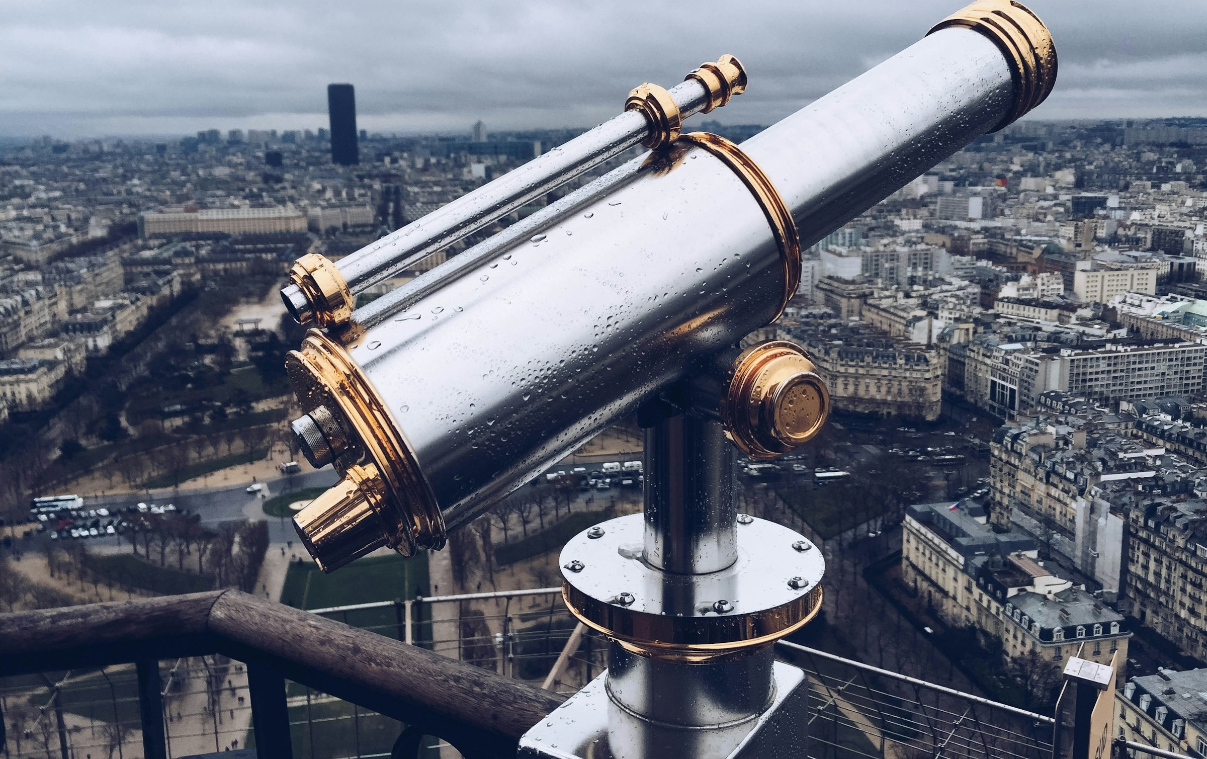
Distant Viewing & the Multimodal Turn
Taylor ARNOLD + Lauren TILTON
Lancaster University
Management School, Lecture Theatre 3
Lancaster, United Kingdom
21 May 2025, 15h15 > 16h30
https://distantviewing.org

Slide 2

1. Introduction
01 – Distant Viewing | Introduction

Slide 3
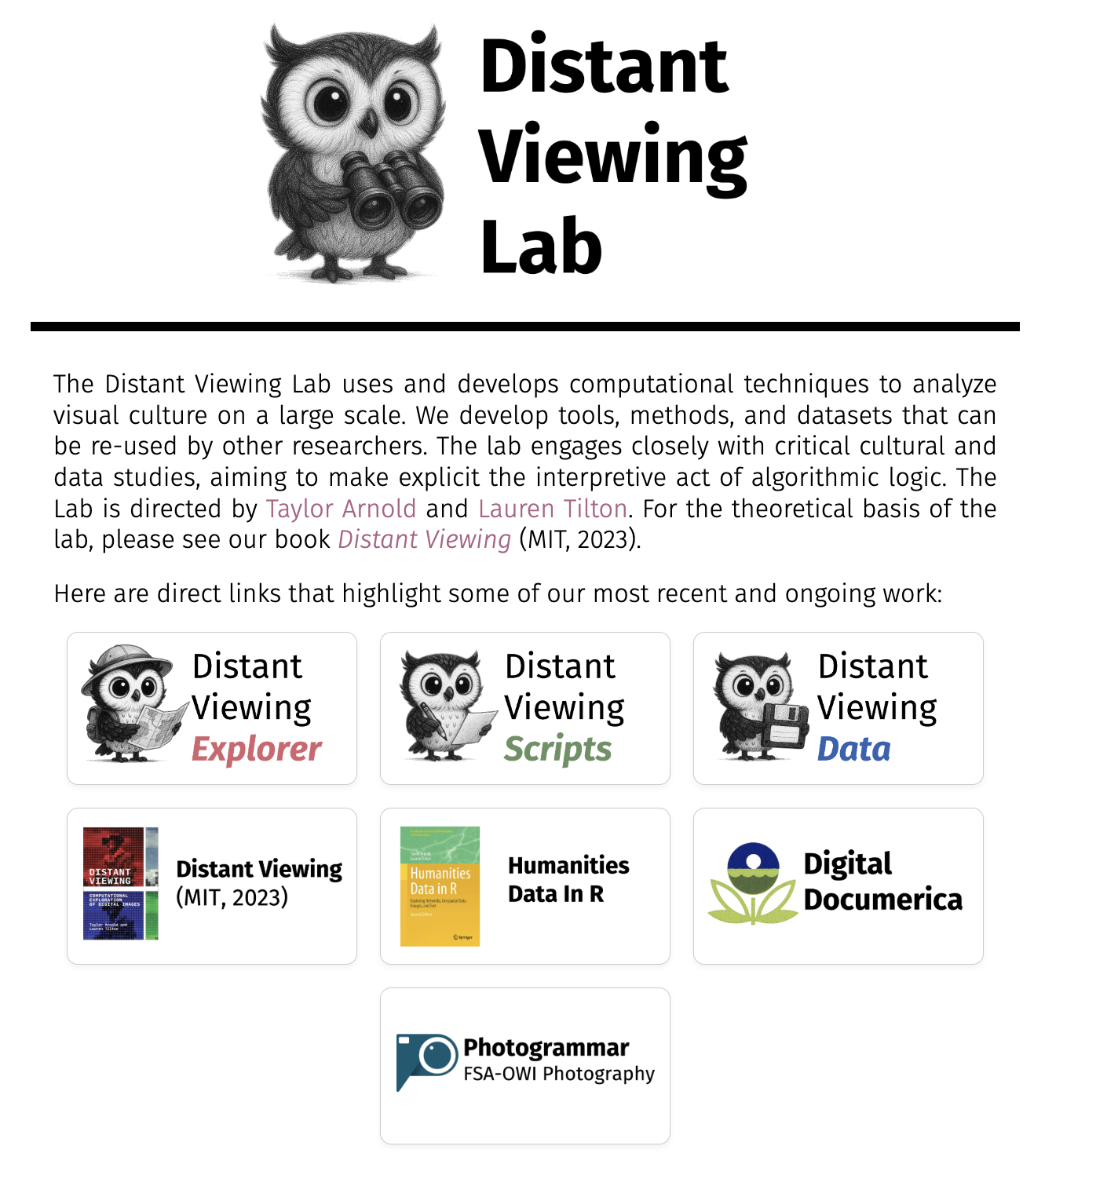


Distant Viewing Lab
The Distant Viewing Lab uses and develops computational techniques to analyze visual culture on a large scale.
We develop tools, methods, and datasets that can be re-used by other researchers. The lab engages closely with critical cultural and data studies, aiming to make explicit the interpretive act of algorithmic logic.
https://distantviewing.org
Generously supported through funding from:
01 – Distant Viewing | Introduction

Slide 4
2. DOCUMERICA
02 – Distant Viewing | DOCUMERICA

Slide 5
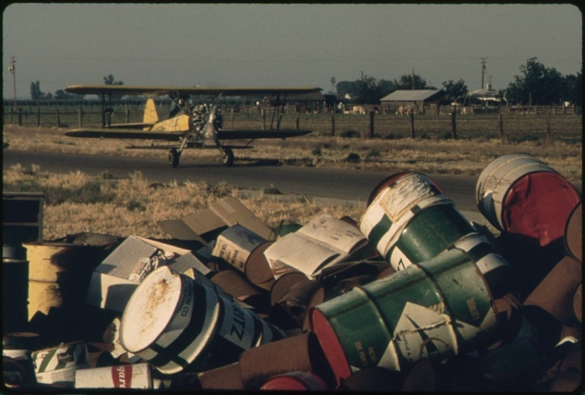
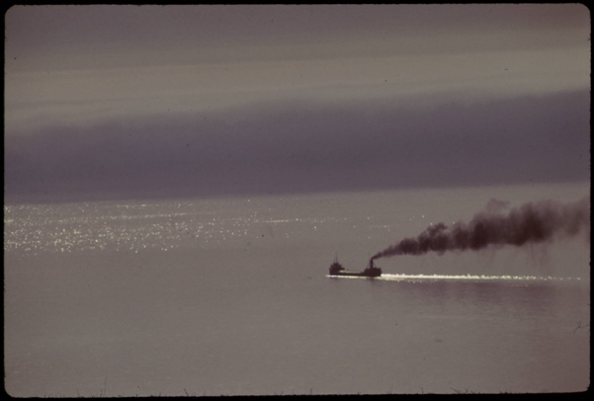
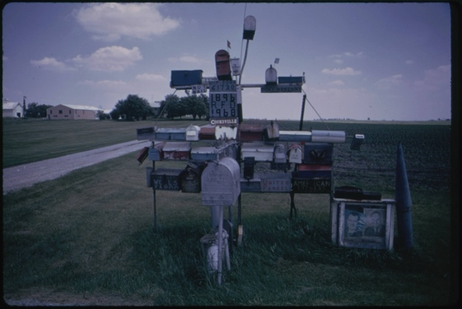
DOCUMERICA
From 1972 to 1978 the U.S. Environmental Protection Agency (EPA) sponsored the DOCUMERICA photography project to document contemporary environment issues and highlight ongoing work by the agency.
Gene Daniels, Discarded Pesticide Cans (May 1972).
Donald Emmerich, Ore Carrier Heads into Lake Superior (June 1973).
Arthur Greenberg, Excentric Mailbox Display (June 1973).
02 – Distant Viewing | DOCUMERICA

Slide 6
DOCUMERICA
From 1972 to 1978 the U.S. Environmental Protection Agency (EPA) sponsored the DOCUMERICA photography project to document contemporary environment issues and highlight ongoing work by the agency.
The U.S. National Archives and Records Administration (NARA) has digitized and made available nearly 16,000 images taken by the DOCUMERICA photographers.
Gene Daniels, Discarded Pesticide Cans (May 1972).
Donald Emmerich, Ore Carrier Heads into Lake Superior (June 1973).
Arthur Greenberg, Excentric Mailbox Display (June 1973).
02 – Distant Viewing | DOCUMERICA

Slide 7
DOCUMERICA
From 1972 to 1978 the U.S. Environmental Protection Agency (EPA) sponsored the DOCUMERICA photography project to document contemporary environment issues and highlight ongoing work by the agency.
The U.S. National Archives and Records Administration (NARA) has digitized and made available nearly 16,000 images taken by the DOCUMERICA photographers.
Public interest in the collection has recently grown with the increased focus on environmental concerns. While the images are freely accessible from the NARA website and released into the public domain, the ability to understand the scope of the collection in its current form is limited.
Gene Daniels, Discarded Pesticide Cans (May 1972).
Donald Emmerich, Ore Carrier Heads into Lake Superior (June 1973).
Arthur Greenberg, Excentric Mailbox Display (June 1973).
02 – Distant Viewing | DOCUMERICA

Slide 8
DOCUMERICA
The research question that drives our work today:
How can we use computational approaches to help organize and create generous interfaces for this important photographic archive?
Gene Daniels, Discarded Pesticide Cans (May 1972).
Donald Emmerich, Ore Carrier Heads into Lake Superior (June 1973).
Arthur Greenberg, Excentric Mailbox Display (June 1973).
02 – Distant Viewing | DOCUMERICA

Slide 9
3. Theory
02 – Distant Viewing | Theory

Slide 10
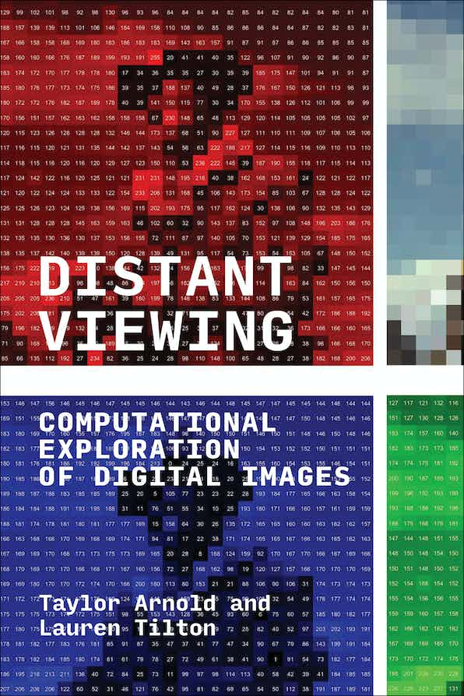
Distant Viewing Book (2023)
For more details about the theory and method of distant viewing, please check out our recently published book Distant Viewing (MIT Press, 2023). It has been released under an OA license and can be freely downloaded from the following link:
https://distantviewing.org/book
Distant Viewing: Computational Exploration of Digital Images
By Taylor Arnold, Lauren Tilton
The MIT Press
DOI: https://doi.org/10.7551/mitpress/14046.001.0001
ISBN electronic: 9780262375160
In Special Collection: CogNet
Publication date: October 2023
03 – Distant Viewing | Theory

Slide 11
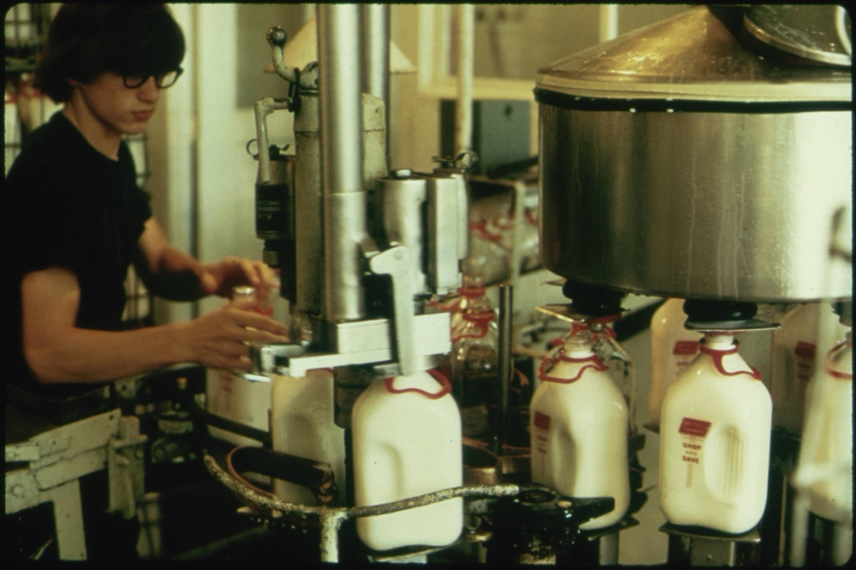
Distant Viewing Theory: Overview
Flip Schulke, Employee of the Donald Dannheim Family who operate a dairy and ice cream store (July 1974).
Distant Viewing is a theory of how the computational exploration of digital images through the application of computer vision works, and why it is needed.
starting image
03 – Distant Viewing | Theory
T. Arnold and L. Tilton, (2023) Distant Viewing, MIT Press.

Slide 12
Distant Viewing Theory: Overview
Flip Schulke, Employee of the Donald Dannheim Family who operate a dairy and ice cream store (July 1974).
Distant Viewing is a theory of how the computational exploration of digital images through the application of computer vision works, and why it is needed.
Mimetic nature of images necessitates that the computational analysis of digital images starts with the extraction of semantic metadata using computer vision.
starting image
annotations
black, brown, white
{ bottle, milk }
indoors
1 person
03 – Distant Viewing | Theory
T. Arnold and L. Tilton, (2023) Distant Viewing, MIT Press.

Slide 13
Distant Viewing Theory: Overview
Flip Schulke, Employee of the Donald Dannheim Family who operate a dairy and ice cream store (July 1974).
Distant Viewing is a theory of how the computational exploration of digital images through the application of computer vision works, and why it is needed.
Mimetic nature of images necessitates that the computational analysis of digital images starts with the extraction of semantic metadata using computer vision.
The process of constructing annotations is a computationally mediated form of “viewing”.
starting image
annotations
black, brown, white
{ bottle, milk }
indoors
1 person
03 – Distant Viewing | Theory
T. Arnold and L. Tilton, (2023) Distant Viewing, MIT Press.

Slide 14
Distant Viewing Theory: Overview
Flip Schulke, Employee of the Donald Dannheim Family who operate a dairy and ice cream store (July 1974).
Distant Viewing is a theory of how the computational exploration of digital images through the application of computer vision works, and why it is needed.
Mimetic nature of images necessitates that the computational analysis of digital images starts with the extraction of semantic metadata using computer vision.
The process of constructing annotations is a computationally mediated form of “viewing”.
The application of computer vision is not a neutral process. It engages in socially mediated ways of seeing and viewing that are encoded into the algorithms and the ways that they are used.
starting image
annotations
black, brown, white
{ bottle, milk }
indoors
1 person
03 – Distant Viewing | Theory
T. Arnold and L. Tilton, (2023) Distant Viewing, MIT Press.

Slide 15
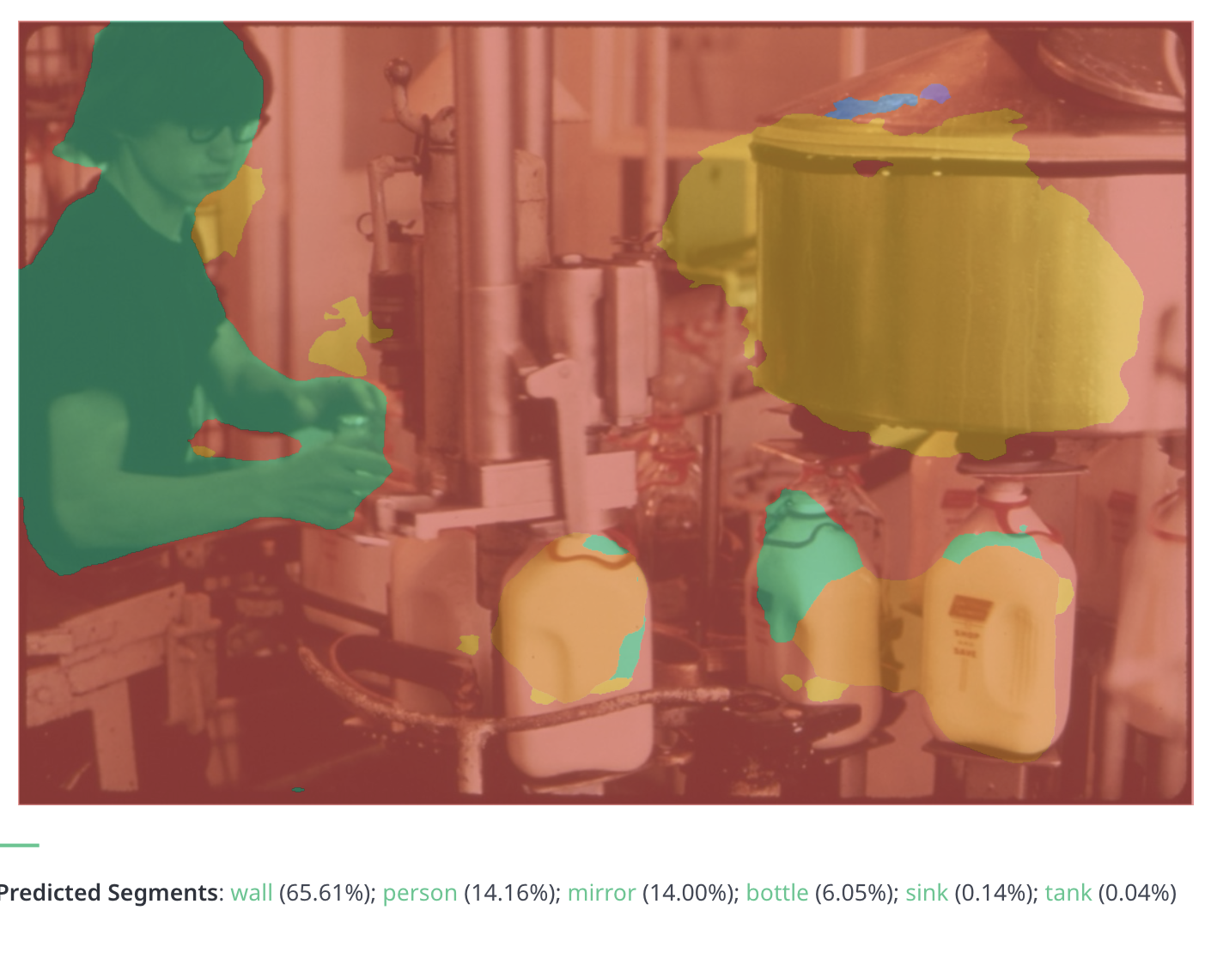
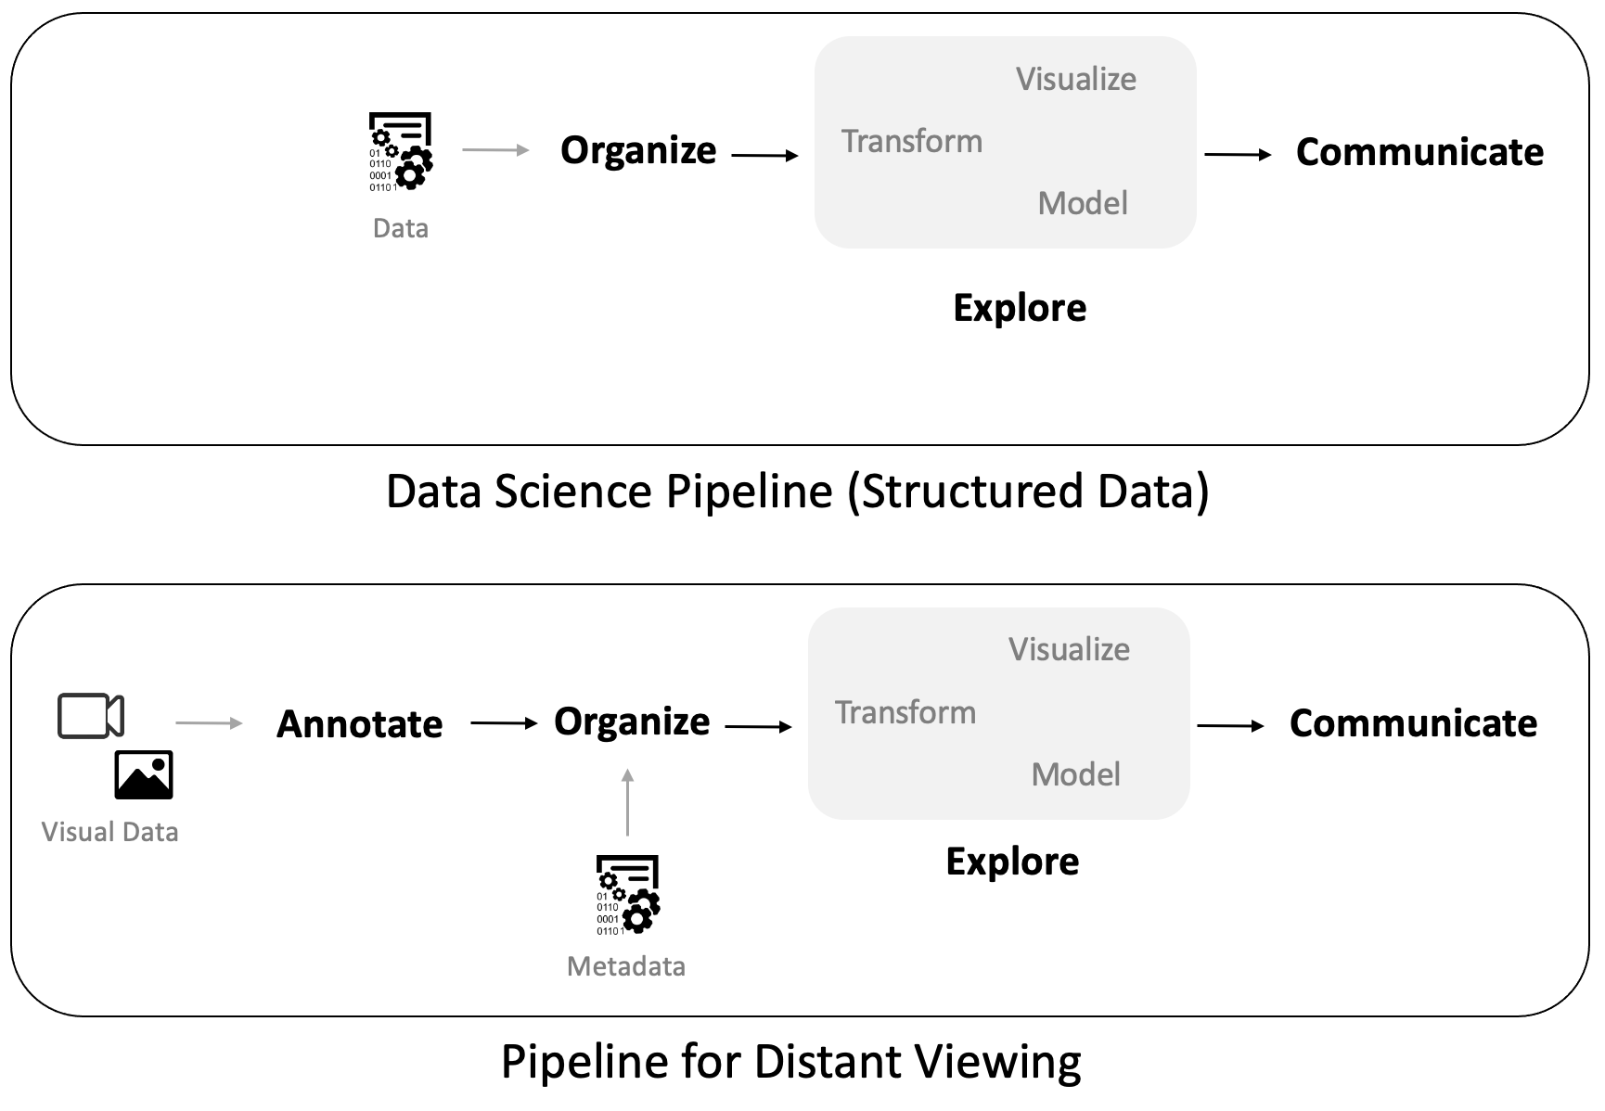
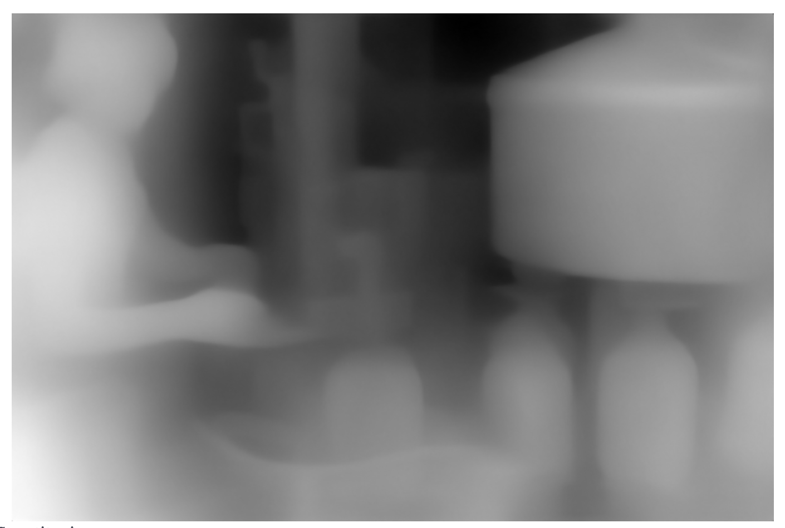
Distant Viewing: From Theory to Method
The theory of Distant Viewing influences the way that we think about doing computational analysis with visual and multimodal data.
02 – Distant Viewing | Method
T. Arnold and L. Tilton, (2023) Distant Viewing, MIT Press.
Notes:
Now that we have heorized how distnat viewing works, we can reutn

Slide 16
4. Three "Classic" Approaches
04 – Distant Viewing | Classic Approaches

Slide 17
Approach 1: Use the Metadata
One possibility is to built a public interface around existing metadata. This can be a powerful technique, particularly when rich metadata is already available and aligns well with the kinds of exploration and discovery that users of the collection are interested in.
The DOCUMERICA corpus includes some limited but fairly consist metadata, but most photos do include a location (at the level of a town),date (month and year), and the name of the photographer. Most images have captions; some of these are several sentences, whereas many only include a few key terms.
July 1974
Flip Schulke
New Ulm, Minnesota
04 – Distant Viewing | Classic Approaches

Slide 18
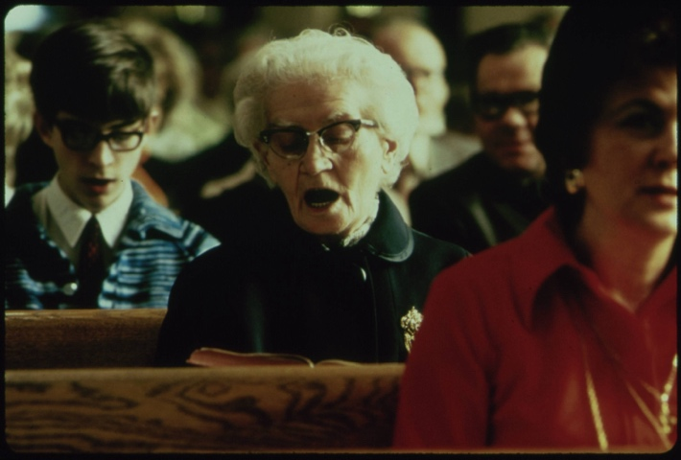
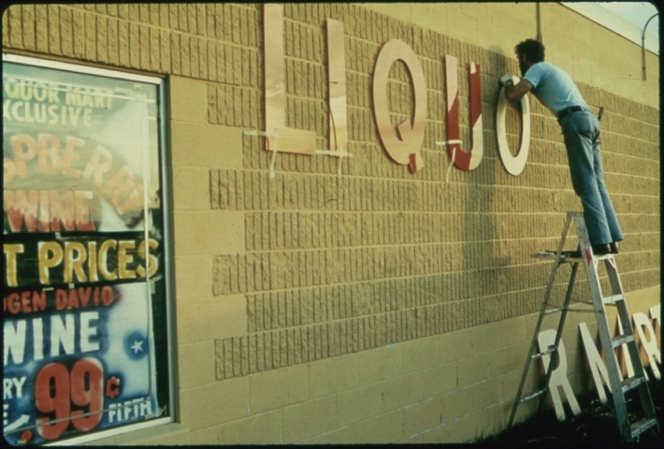
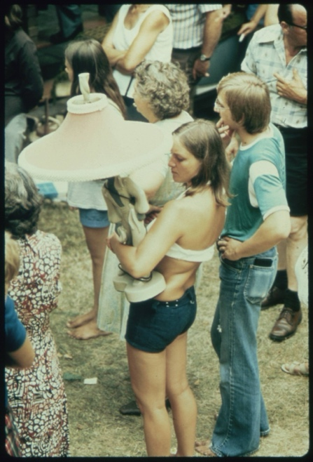
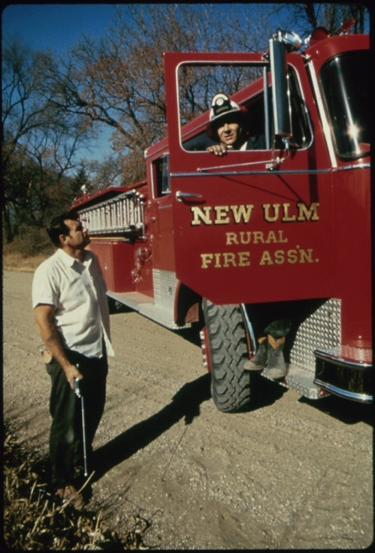
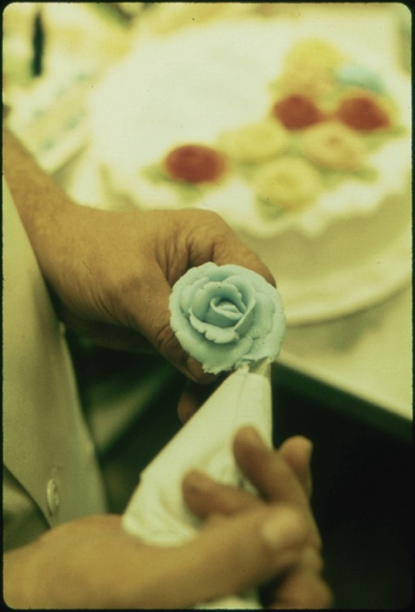
Approach 1: Use the Metadata
For example, here are the other images that have the same photographer, location, and date as our starting image. It seems that Flip Schulke took a variety of images throughout the town of Ulm, Minnesota during his visit in July 1074.
Flip Schulke, Five Photos from Ulm, Minnesota, Documerica Project (July 1974).
04 – Distant Viewing | Classic Approaches

Slide 19
Approach 1: Use the Metadata
Advantages
Relatively easy to integrate into a public interface.
Simple to explain, understand, and regulate.
Can be used with nearly any kind of archive.
Avoids some potential difficulties that government archives have with creating/displaying original information.
Difficulties
Can only be used with collections that have rich metadata.
Locked into the archival logic of the collection.
Metadata may be too granular or too coarse for specific applications.
Does not use the visual component of the images in a direct way.
Flip Schulke, Five Photos from Ulm, Minnesota, Documerica Project (July 1974).
04 – Distant Viewing | Classic Approaches

Slide 20
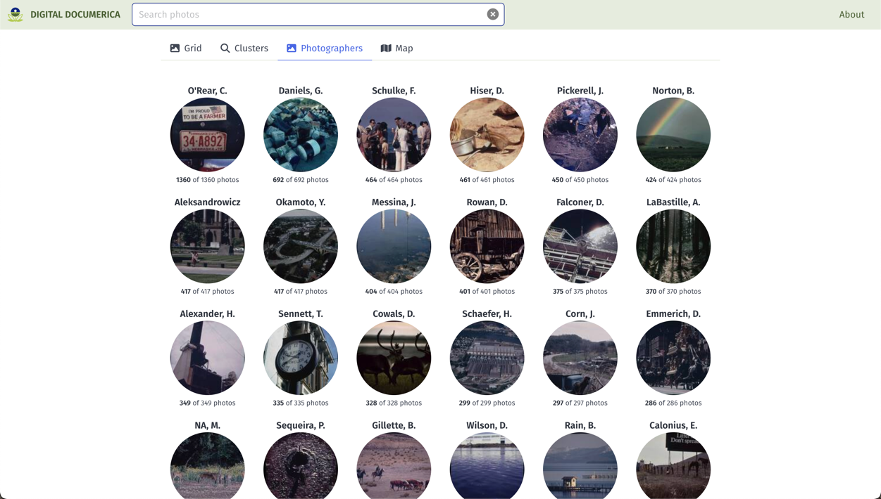
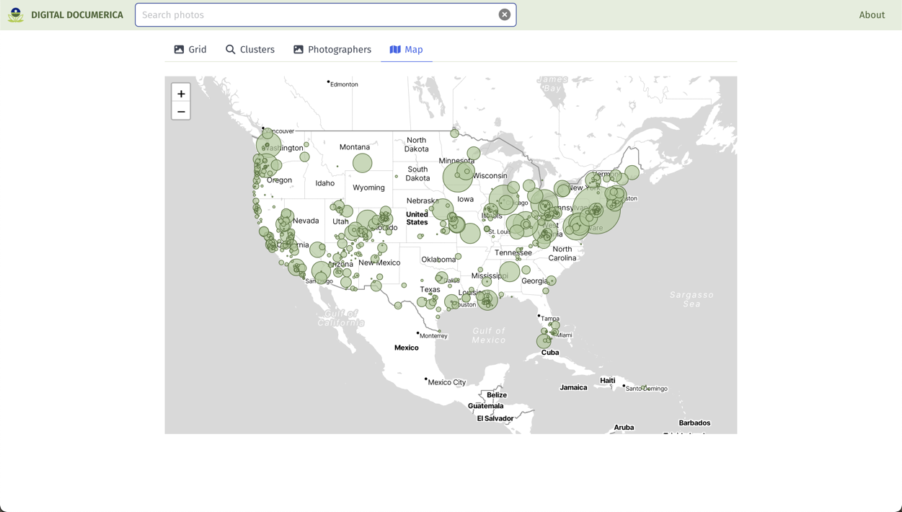
Approach 1: Use the Metadata
Metadata continues to be an important search and discovery tool. We have built in several faceted search and discovery methods in our interface for Documerica.
On the right are screenshots showing examples of searching the collection by photographer name (top) and the photo location (bottom).
T. Arnold, P. Leonard and L. Tilton. (2017) "Knowledge Creation Through Recommender Systems." Digital Scholarship in the Humanities, 32.3: 151-157.
04 – Distant Viewing | Classic Approaches

Slide 21
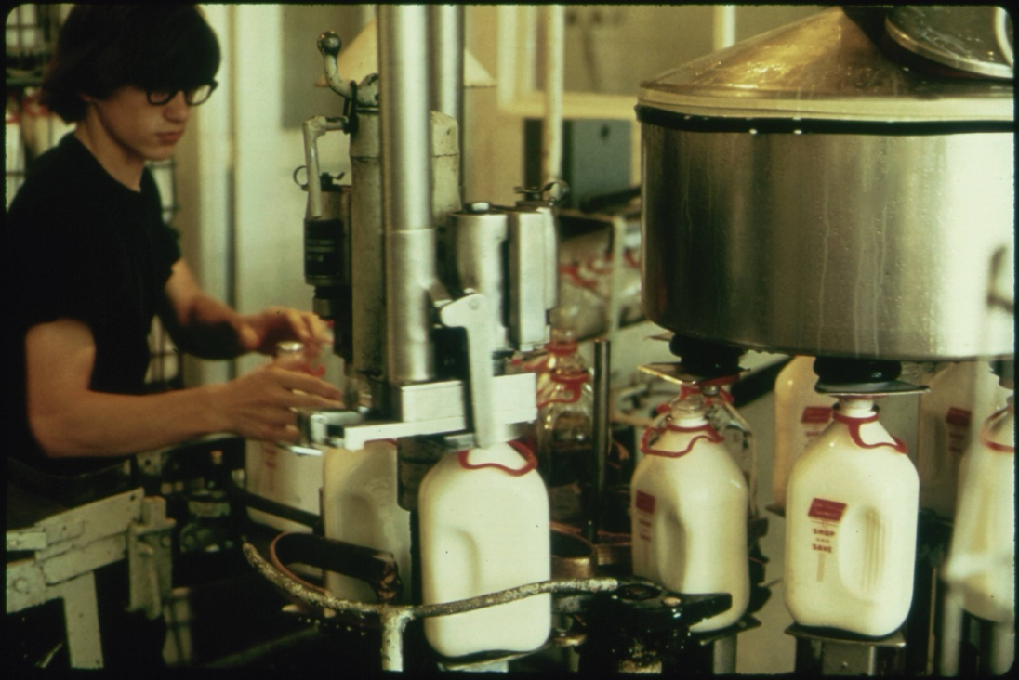

Approach 2: Supervised ML with Computer Vision
A second approach that have become increasingly possible is the application of computer vision algorithms to tag images with specific features using pre-built models.
For example, face detection can identify with a high degree of accuracy the location of all faces within an image.
The detected objects can be used as additional metadata that can then be search and aggregated for.
{ faces: 1 }
04 – Distant Viewing | Classic Approaches

Slide 22
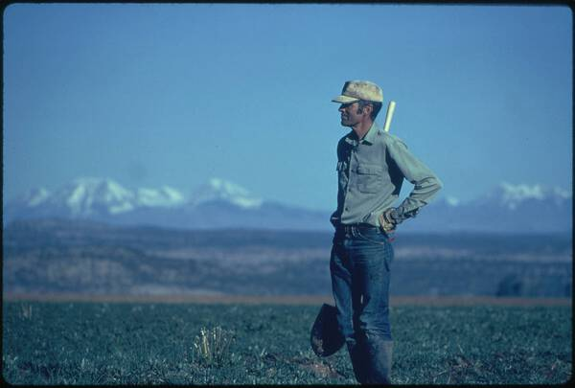
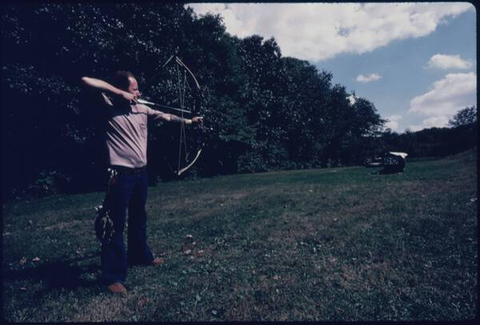
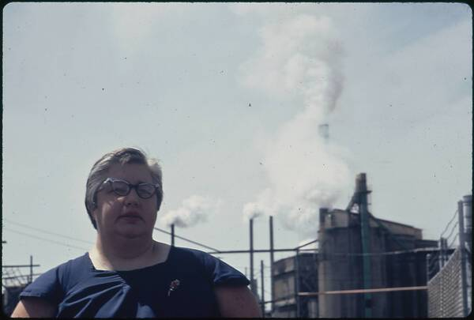
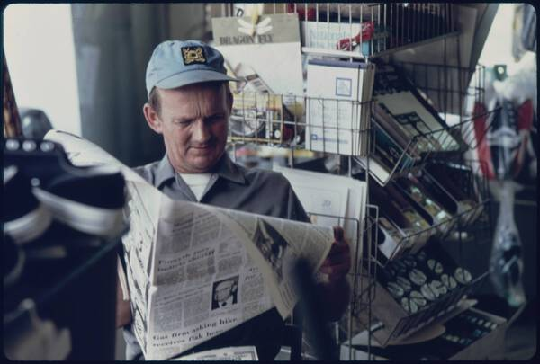
Approach 2: Supervised ML with Computer Vision
Using our example image, here are the six images in which our computer vision algorithm also detected one face of a similar size.
04 – Distant Viewing | Classic Approaches

Slide 23
Approach 2: Supervised ML with Computer Vision
Advantages
Can be applied to collections with no or limited archival metadata, regardless of size.
Allows integration new kinds of annotation that can cut across extant archival categories.
Difficulties
Need to explain and contextualize the created labels, which may contain errors or produce problematic connections.
Existing tags often do not align with the interesting connections within an archive.
Creating new models can be difficult and time intensive.
For end-users, the outputs are as (if not more) restrictive than with existing metadata categories.
04 – Distant Viewing | Classic Approaches

Slide 24
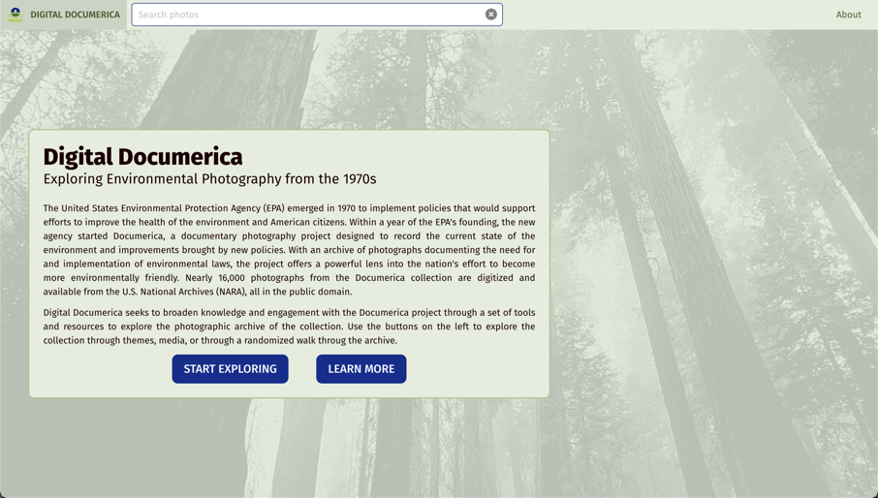

Approach 2: Supervised ML with Computer Vision
We have not integrated explicit tags using supervised machine learning algorithms into previous public digital interfaces, nor have we done so with Documerica.
Our experience is that many algorithms, such as face detection and image segmentation, are too coarse to be of much use in a digital interface (every category would return thousands of images).
04 – Distant Viewing | Classic Approaches

Slide 25

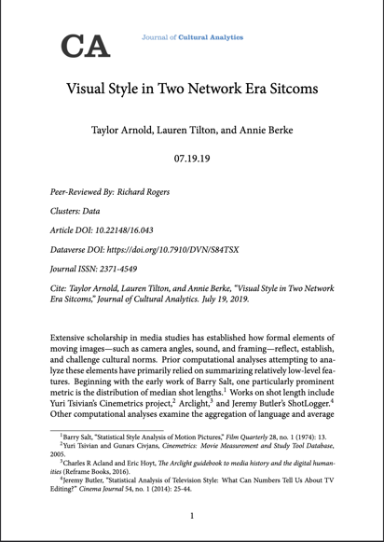
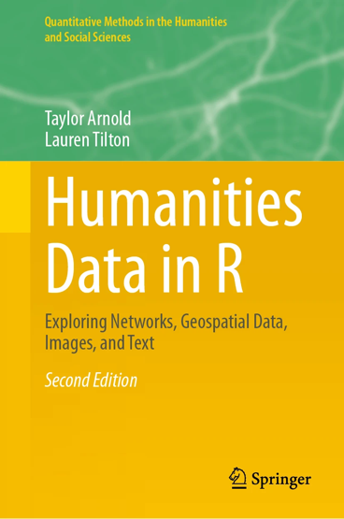
Approach 2: Supervised ML with Computer Vision
We have not integrated explicit tags using supervised machine learning algorithms into previous public digital interfaces, nor have we done so with Documerica.
Our experience is that many algorithms, such as face detection and image segmentation, are too coarse to be of much use in a digital interface (every category would return thousands of images).
However, these models are great for many other applications of distant viewing; the coarseness is a benefit when doing aggregative analyses. We make extensive use algorithms such as face detection in many research applications.
04 – Distant Viewing | Classic Approaches

Slide 26
Approach 3: Visual Embedding
Image embedding algorithms associate an image with a sequence of numbers. The individual numbers have no direct meaning. Instead, the numbers have a relative connection to one another. Images that share common features will have similar sequences of numbers.
Image embeddings can be used to create recommendation systems for digital projects. These allow visitors to follow paths through an archive according to similar visual features.
We can also use embeddings to cluster the images and recommend different parts of the collection that may be of interest to different communities.
246, 170, 58, 175, 215, 117, 35, 63, 134, 218, 167, 126, 141, 236, 231, 165, 192, 177, 153, 44, 135, 196, 252, 28, 172, …..
04 – Distant Viewing | Classic Approaches

Slide 27

Approach 3: Visual Embedding
Most image embedding algorithms are adapted from other computer vision models. For example, the diagram on the right shows the VGG19 model for detecting objects from 1000 different categories. This is a deep learning model that slowly changes each input image (left) into a sequence of probabilities (right).
A particularly interesting thing about deep learning models is that the interior steps tend to capture general features (e.g., texture, shape, and color) that go beyond the specific task at hand.
In particular, the numbers in the penultimate or antepenultimate step can typically be used as an image embedding.
T. Arnold and L. Tilton. (2021) "Depth in Deep Learning: Knowledgeable, Layered, and Impenetrable." In: Redrobe, K. and Scheible, J. (Eds.) Deep Mediations. University of Minnesota Press.
04 – Distant Viewing | Classic Approaches

Slide 28
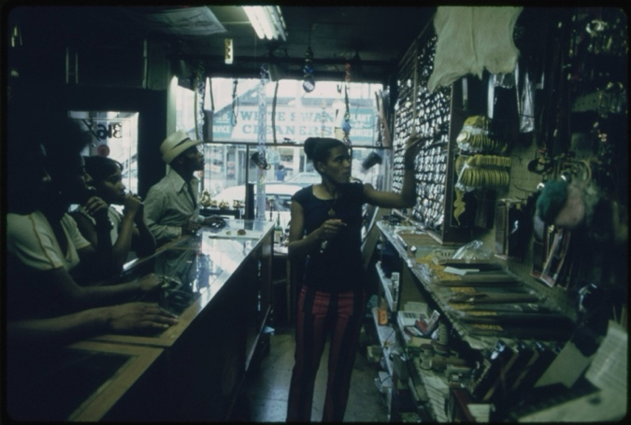
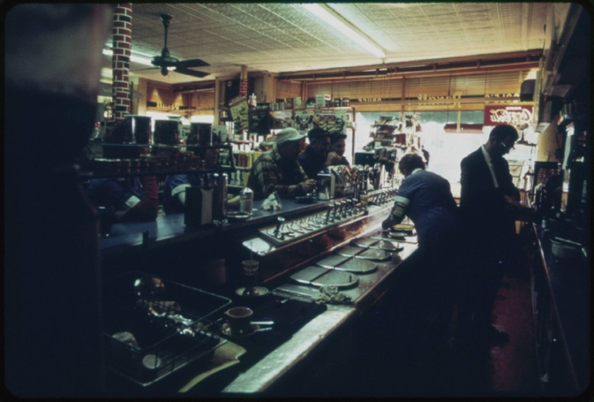
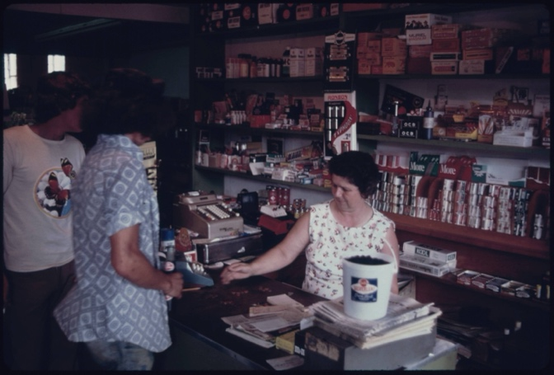
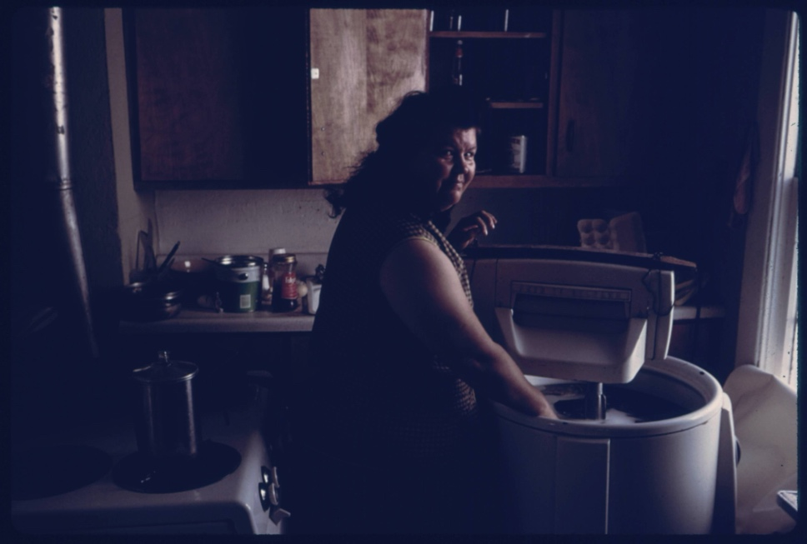
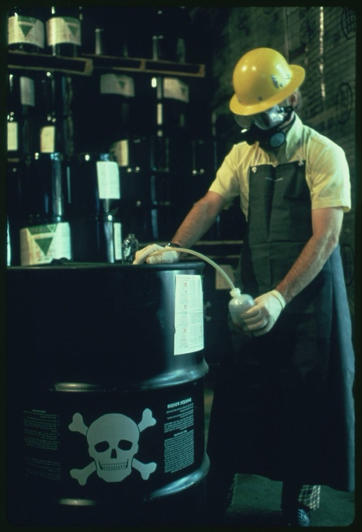
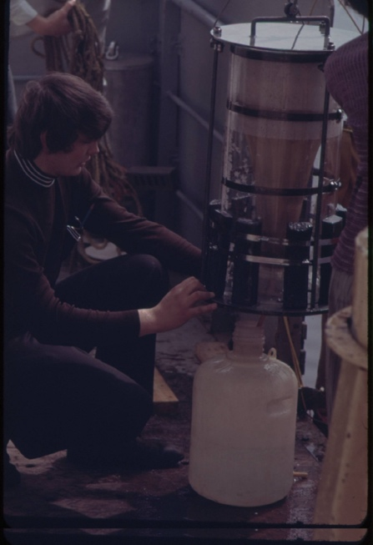
Approach 3: Visual Embedding
Here are the six images that have the most similar set of embedding to our example image using the penultimate layer of the VGG19 model.
04 – Distant Viewing | Classic Approaches

Slide 29
Approach 3: Visual Embedding
Advantages
Can be applied to any collection without need for existing archival metadata or a model specifically designed for a collection.
Adaptable across different collections.
Will cut across existing categories and find connections that have not been explicitly coded for.
Difficulties
No clear way to explain or control the connections and/or clusters.
Can create problematic or odd connections (for example, the link between milk production and radioactive waste).
Embeddings are usually made from object detection algorithms and have difficulty finding certain kinds of connections.
Can be influenced by the photo orientation and resolution.
04 – Distant Viewing | Classic Approaches

Slide 30
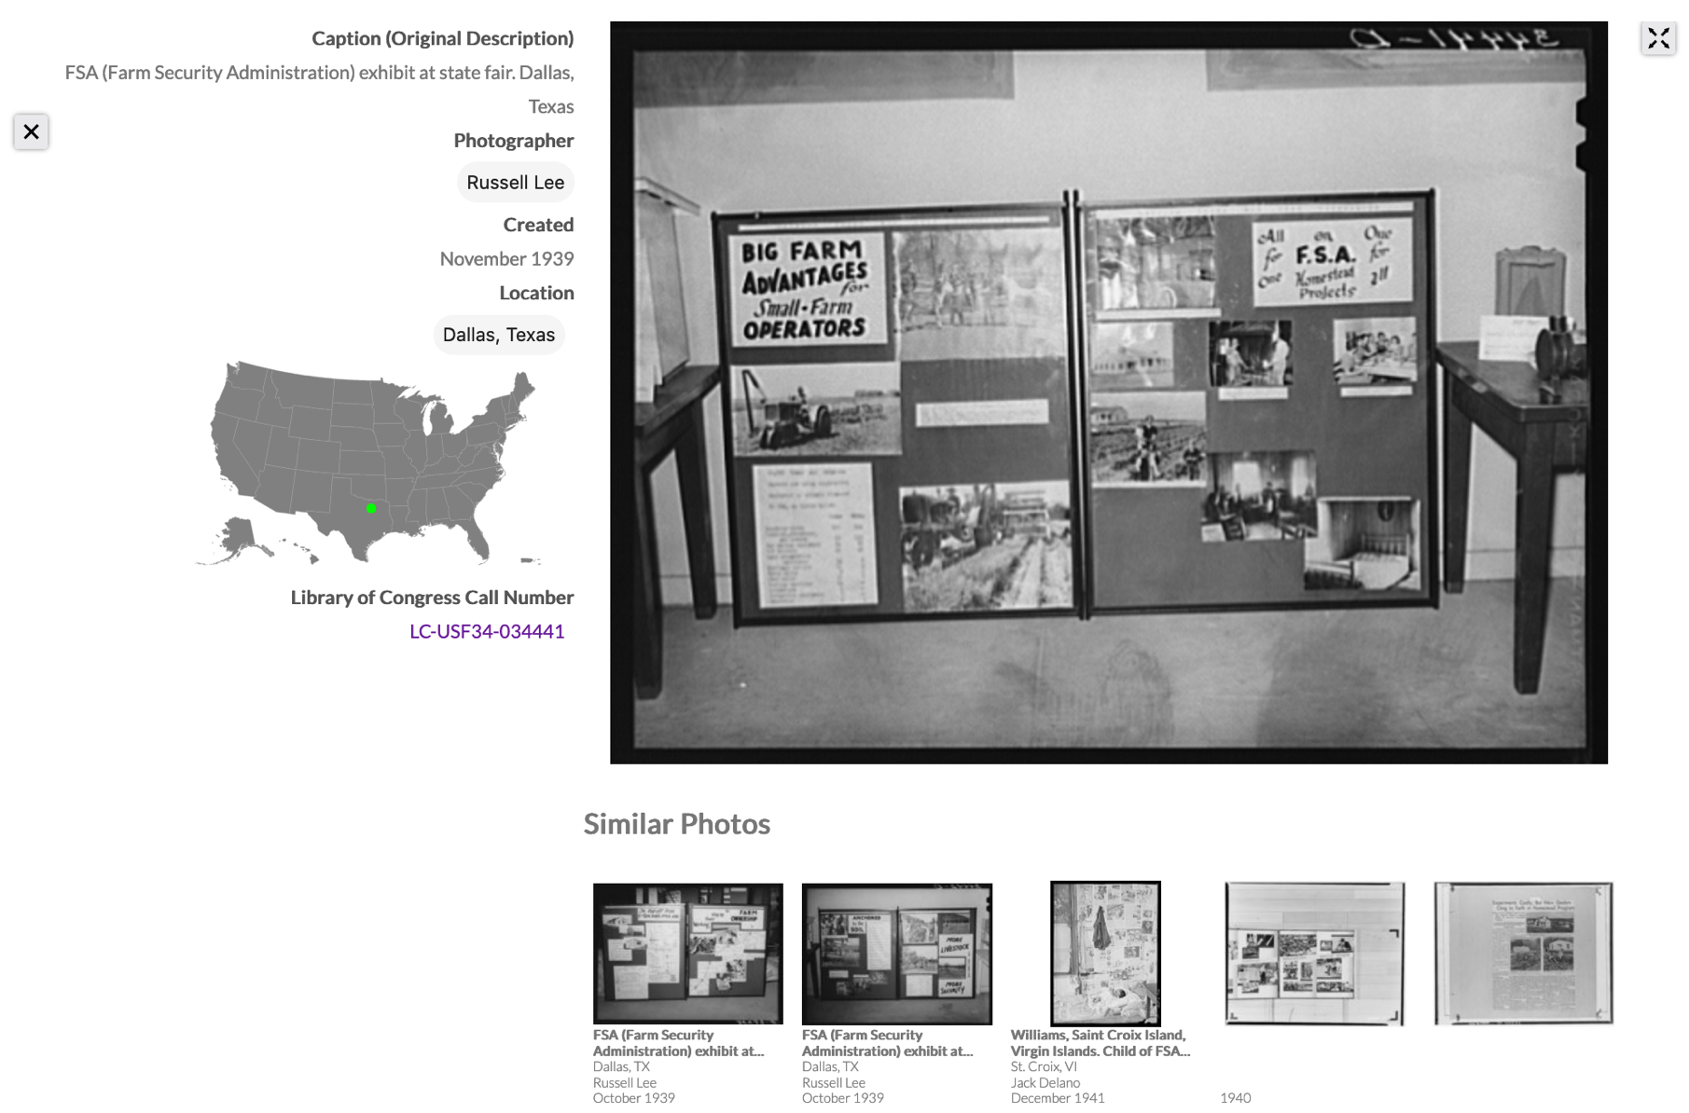
Approach 3: Visual Embedding
These are a powerful tool that we have used in previous projects, such as Photogrammar for search and discovery of the FSA-OWI collection.
We are not using it for Documerica because we we now have a better approach….
T. Arnold and L. Tilton. (2019) "Distant Viewing: Analyzing Large Visual Corpora." Digital Scholarship in the Humanities
04 – Distant Viewing | Classic Approaches

Slide 31
5. Multimodal Large Language Models (MLLMs)
05 – Distant Viewing | MLLMs

Slide 32




Approach 1: Multimodal Large Language Models
Large language models (LLMs) have received a considerable amount of hype and press over the past two years. More recent model versions have included multimodal LLMs (MLLMs), which allow for combining text and image inputs and outputs.
Several MLLMs are currently available, including the most well-known efforts integrated into OpenAI’s ChatGPT, Google’s Gemini, and Anthropic’s Claude.
Several open models such as Qwen-VL LLaVA indicate that versions of MLLMs should be become and remain available for all users.
05 – Distant Viewing | MLLMs

Slide 33

Approach 1: Multimodal Large Language Models
Response: This photograph captures a scene inside an industrial or agricultural processing facility, possibly a dairy. The image focuses on a female worker engaged in operating machinery used for filling milk bottles. She is wearing glasses and a black top, and appears to be adjusting or handling the bottles or the machine. The worker is surrounded by a complex arrangement of stainless steel machinery and equipment. On the right side of the frame, there's a large metal vat or container, possibly holding milk or another liquid, with its lid partially visible. In the foreground, we see a series of white plastic milk bottles, each adorned with a red label. These bottles are lined up on a conveyor belt or a filling station, which seems to be part of a mechanized assembly line designed for packaging. The machinery includes various knobs, valves, metal structures, and hoses participating in the bottling process. The interior setting is lit with what appears to be fluorescent lighting, adding a utilitarian ambience to the workspace. The overall scene conveys a moment of daily operations wherein the worker is focused on ensuring the efficiency and correctness of the bottling process.
Prompt: Provide a detailed plain-text description of the objects, activities, people, background and/or composition of this photograph.
05 – Distant Viewing | MLLMs

Slide 34
Approach 2: Zero-shot Models
Another approach come from what are known as zero-shot models such as CLIP and SigLIP. These embed both text and images into a single space, allowing for the creation of a multimodal distance metric.
782-Dimensional Embedding Space
Flip Schulke, Employee of the Donald Dannheim Family who operate a dairy and ice cream store (July 1974).
"a working filling milk bottles"
05 – Distant Viewing | MLLMs

Slide 35
Approach 2: Zero-shot Models
“Glass bottles” => 2.66
“Milk” => 11.55
“Bottle filling factory” => 18.39
“Milk bottles in a factory” => 32.15
“A man filling bottles of milk” => 98.57
05 – Distant Viewing | MLLMs

Slide 36

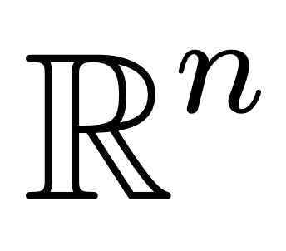
Summary of Multimodal Techniques
#1: MLLMs
#2: Zero-shot
+ PROMPT
“A bottle of milk”
This photograph captures a scene inside…
05 – Distant Viewing | MLLMs

Slide 37
6. Applying Multimodal Methods
06 – Distant Viewing | New Approach

Slide 38
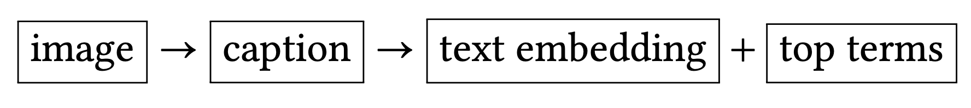
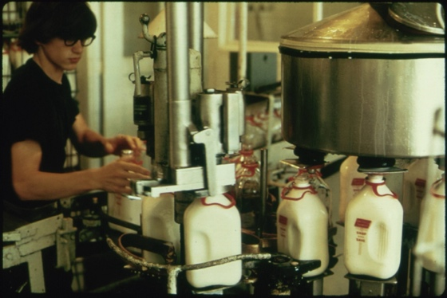
Using MLLMs For Impact and Engagement
MLLMs provide a new approach to opening digital visual archives for increased search and discovery. We can create annotations by passing pairs of images and prompts together and storing the output.
The output can then by converted into text-based embeddings (created and used similarly to image embeddings) as well as top terms (using something such as TF-IDF and used like tags from archival metadata or supervised learning).
107, 230, 13, 85, 124, 65, 191, 221, 150, 6, 223, 242, 11, ….
text embedding
{ dairy, milk, glasses, machinery, worker, machinery }
image
top-terms
This photograph captures a scene inside an industrial dairy. The image focuses on a female worker engaged in operating machinery used for filling milk bottles….
caption
06 – Distant Viewing | New Approach

Slide 39
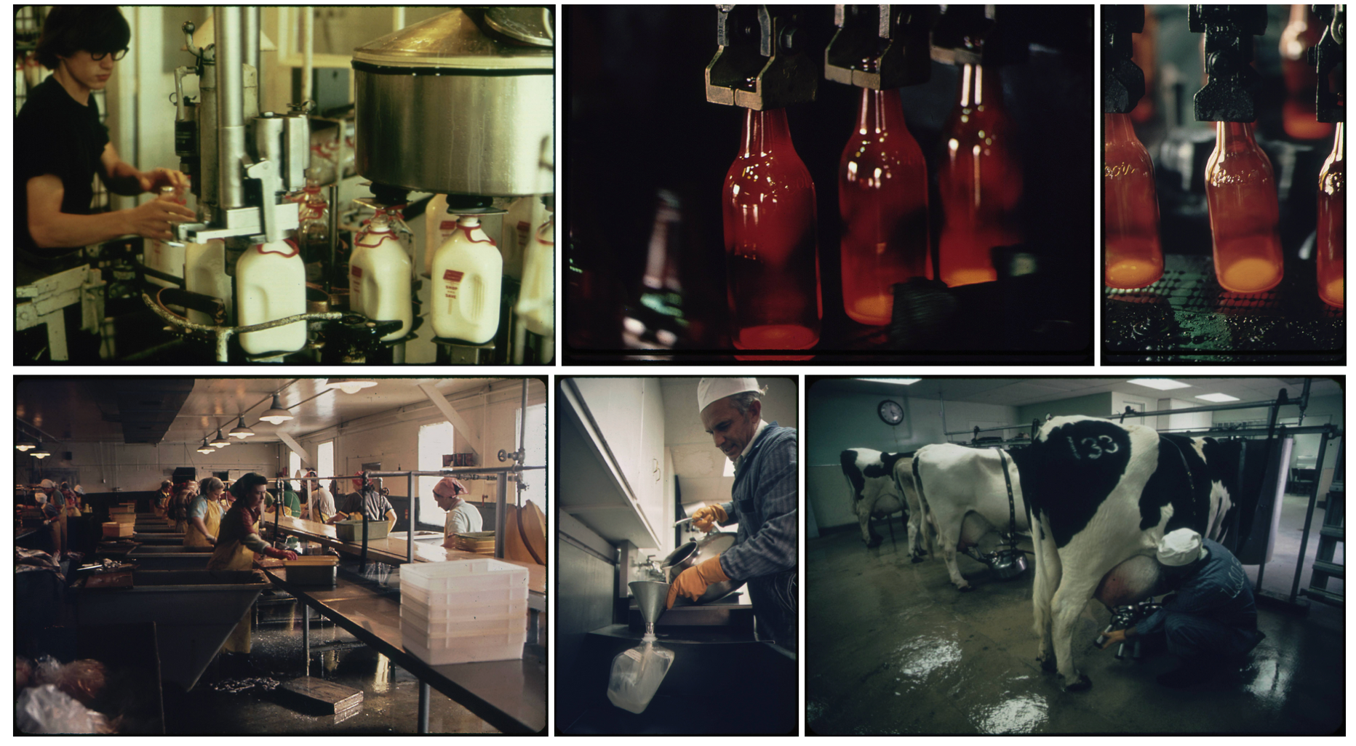
Using MLLMs For Impact and Engagement
Here is our reference image along with the five images have the closest embedding based on the textual embedding of their automatically created captions.
Take note of the differences between the kinds of connections made here and those found in those using only image-based recommendations. The text recommendations find deeper semantic connections, such as the milking of cows and the bottling of milk, that would not come from the image-based approach.
06 – Distant Viewing | New Approach

Slide 40
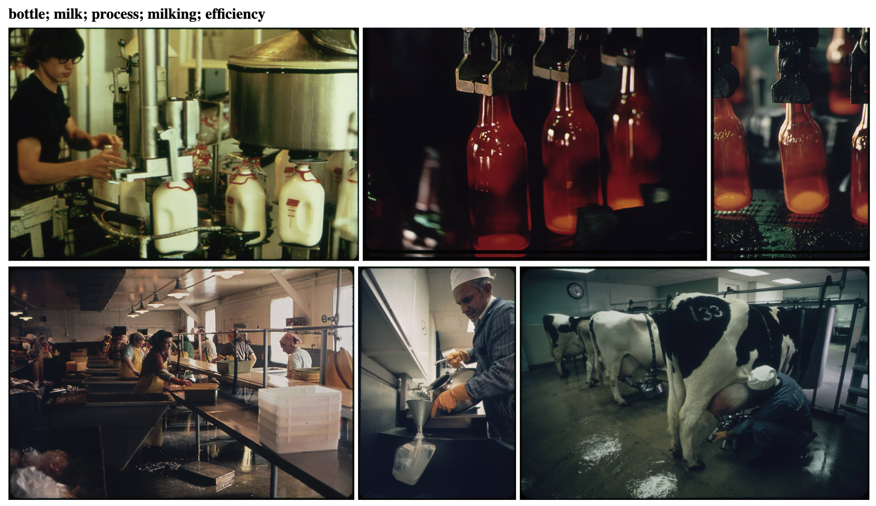
Using MLLMs For Impact and Engagement
Here is our reference image along with the five images have the closest embedding based on the textual embedding of their automatically created captions.
Take note of the differences between the kinds of connections made here and those found in those using only image-based recommendations. The text recommendations find deeper semantic connections, such as the milking of cows and the bottling of milk, that would not come from the image-based approach.
We can even use the captions to determine a label for for the recommendations.
06 – Distant Viewing | New Approach

Slide 41
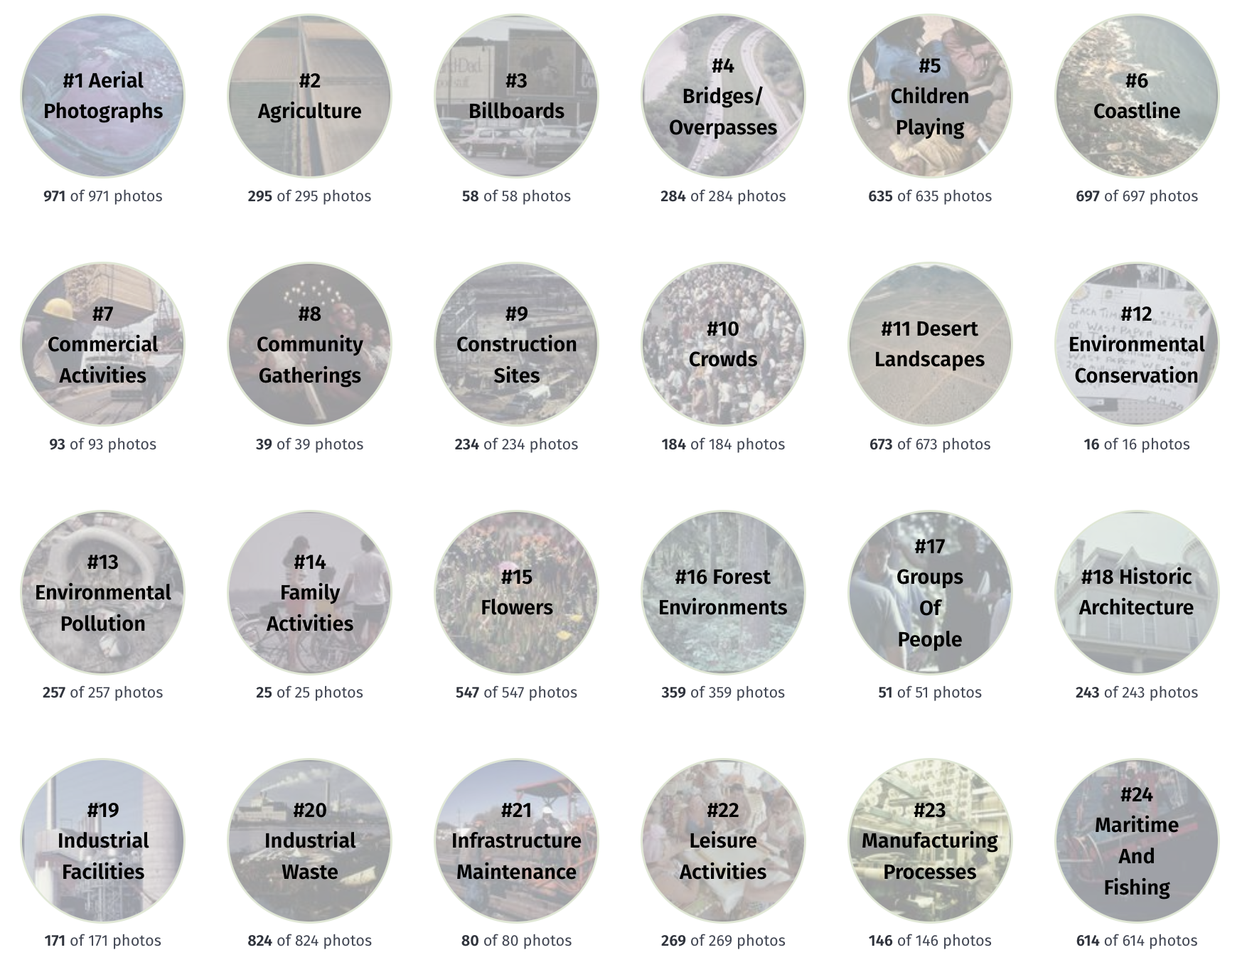
Using MLLMs For Impact and Engagement
We can also use the MLLM output to get a global view of the collection to understand its structure and scope.
On the right are clusters identified based on the captions generated by the MLLM model applied to the Documerica collection.
06 – Distant Viewing | New Approach

Slide 42
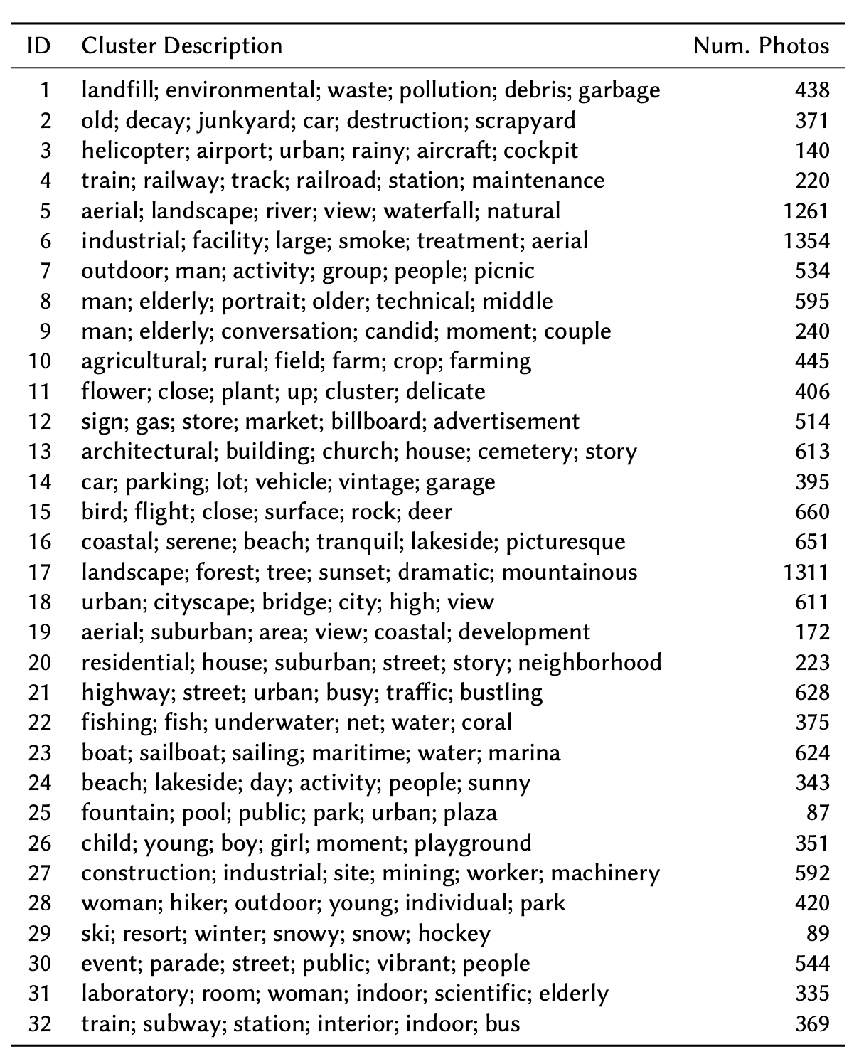
Using MLLMs For Impact and Engagement
We can also use the MLLM output to get a global view of the collection to understand its structure and scope.
Digging deeper, we see the keywords associated with each of these clusters.
06 – Distant Viewing | New Approach

Slide 43
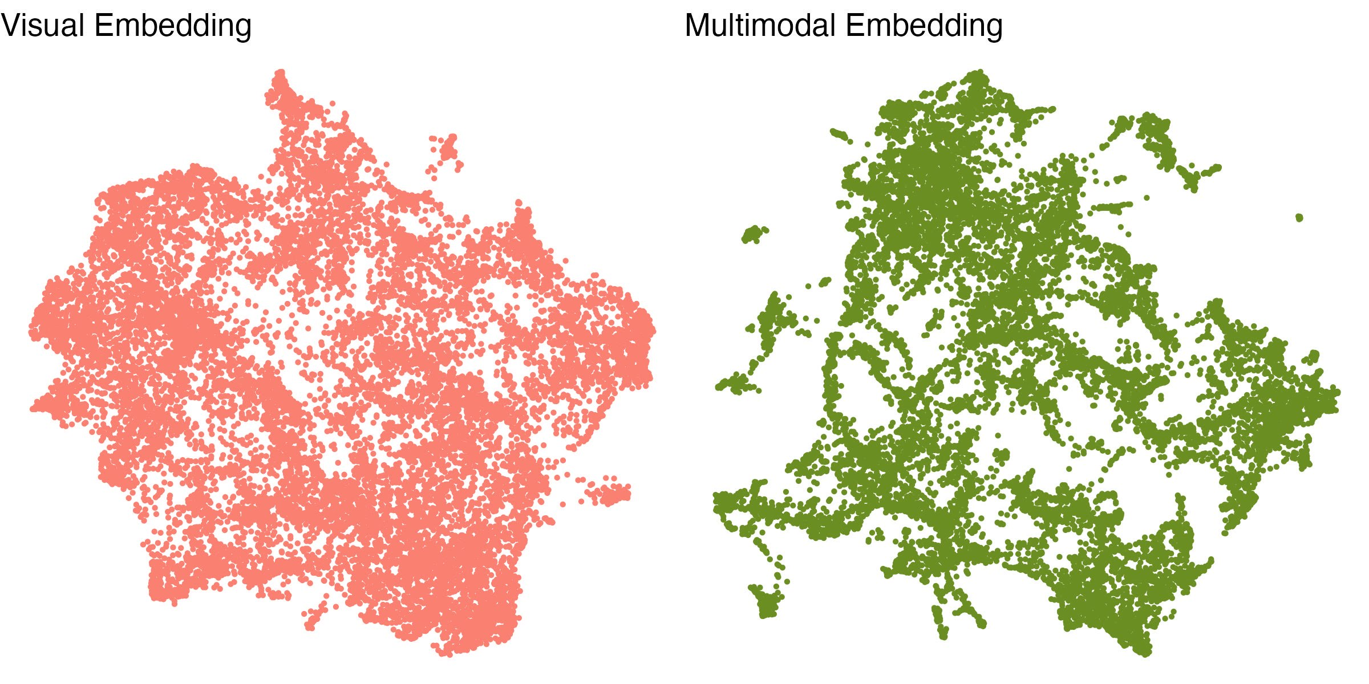
Using MLLMs For Impact and Engagement
We can also visualize the entire collection using techniques such as UMAP. Here, we see the different structures of the visual embedding techniques compared to the multimodal embeddings.
06 – Distant Viewing | New Approach

Slide 44

Using MLLMs For Impact and Engagement
Advantages
Can be used on any collection without the need for existing metadata.
The automatic captions can be used as both search and recommendation system.
Able to explain the connections between images.
Can filter/edit the text to try to avoid certain kinds of connections.
Can open the captions for inquiry or hide them to avoid exposing false-inferences.
Works on a variety of inputs, including art works and printed materials.
Continued Questions and Challenges
Questions about biases in the data (often not public).
Determining good prompts and models to use for specific applications.
Cost associated with non-public APIs or need to acquire large computing resources for public models.
06 – Distant Viewing | New Approach

Slide 45
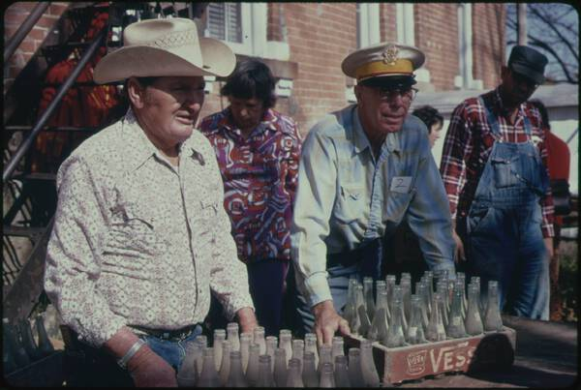

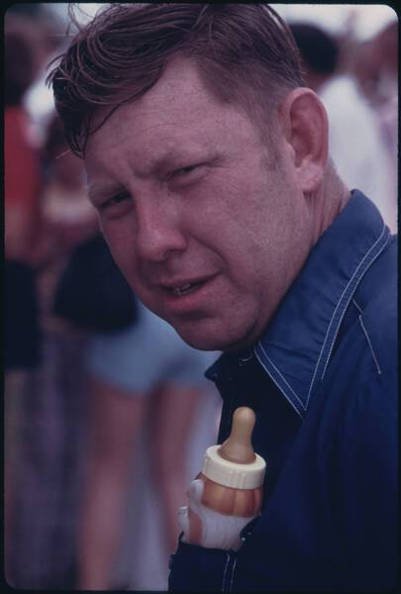
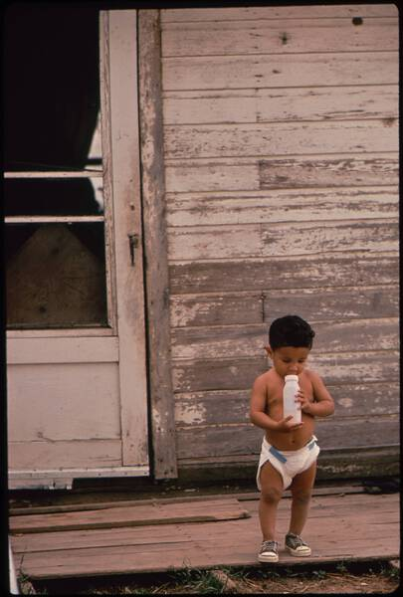
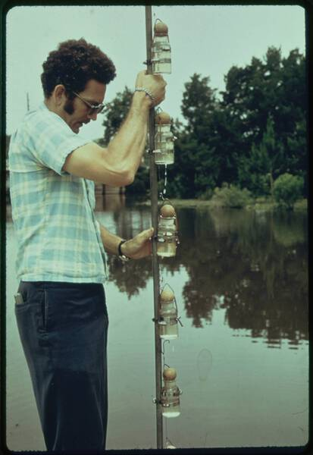
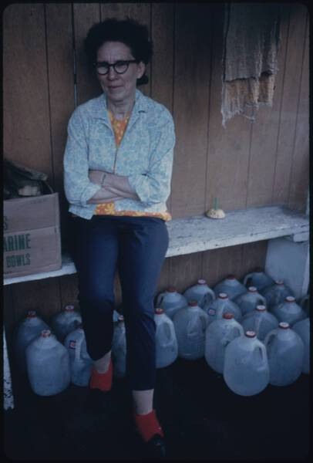
Zero-shot Models For Impact and Engagement
Models such as SigLIP also offer an approach to search and discovery of visual image. We can allow users to write a search query, apply the embedding, and then display images from the most to the least similar.
On the right are the images that most closely match the query “milk bottle”
06 – Distant Viewing | New Approach

Slide 46
Zero-shot Models For Impact and Engagement
Advantages
Allows for alternative terminologies that may have a different level of specificity (i.e., animal > sheep > lamb).
Can query complex phrases that include colors, numbers, and positions.
Returns an ordering of the results, which allows for finding the “best” fits for topics popular across the corpus.
Continued Questions and Challenges
No control over potentially negative queries and their results.
Difficult/impossible to find a cut-off value that indicates how many total matches there are in the collection.
Works a fixed rescaled size of the image. Difficulties with complex, high-resolution images (break them up?).
06 – Distant Viewing | New Approach

Slide 47
7. Digital Documerica
https://digitaldocumerica.org
07 – Distant Viewing | Theory + MLLMs

Slide 48
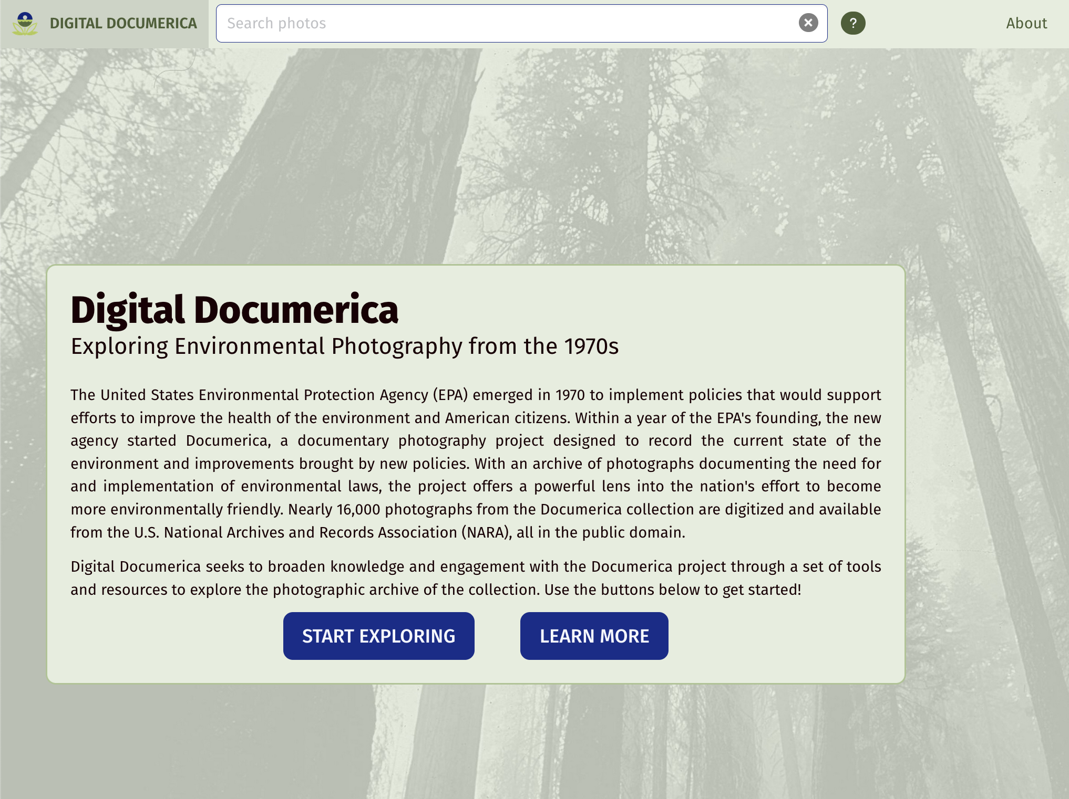
Digital Documerica
We have built a public digital project illustrating how these features can be integrated into a search and discovery interface.
The site allows us to (1) easily explore the possibilities of the methods and (2) see some possibilities for language surrounding the use of AI methods in public archival projects.
07 – Distant Viewing | Digital Documerica

Slide 49
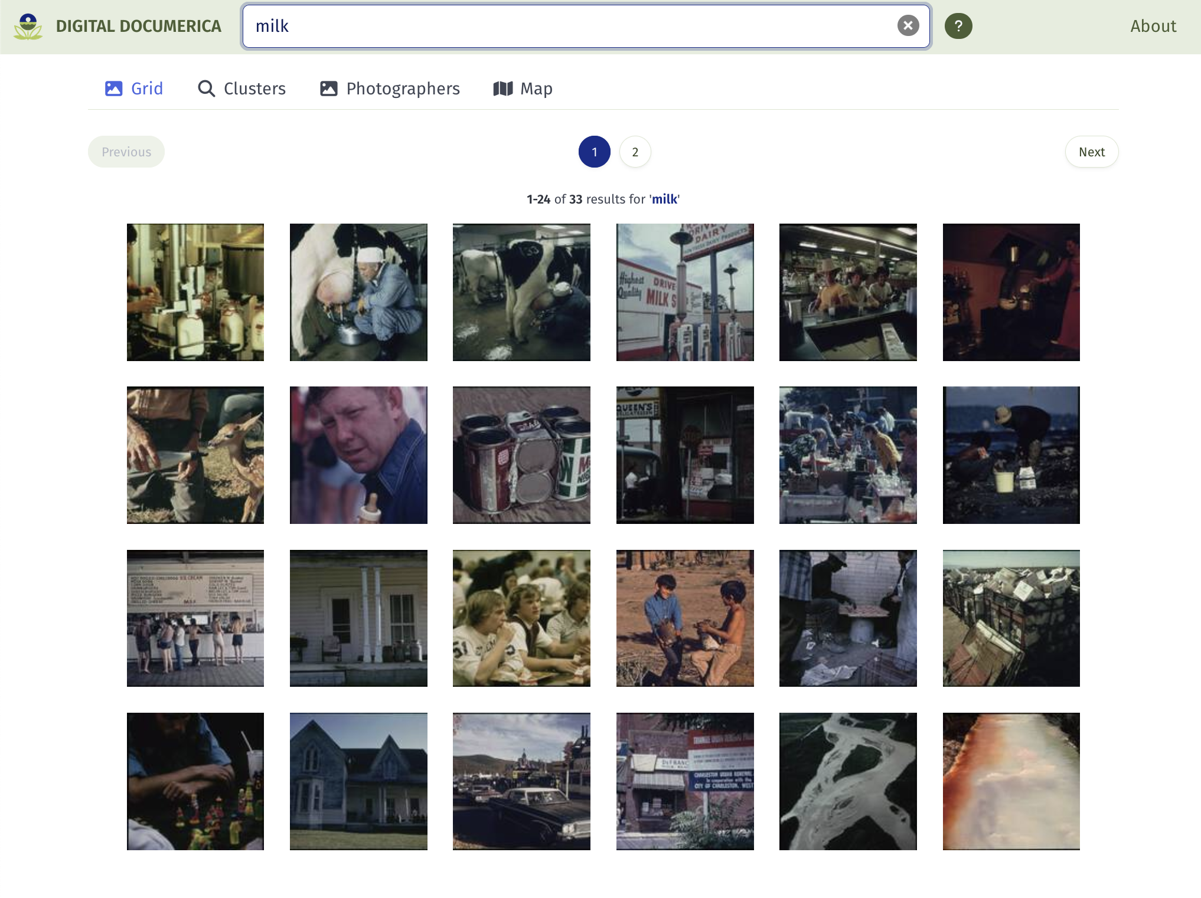
Digital Documerica
The site allows for full-text search of the existing metadata and auto-generated captions.
After the captions are used to filter the collection the SigLIP model is used. We embed the search term (live, in the browser), and sort the results from the most similar to the caption "milk" to the least similar.
Here are the 24 most milk-like images from the total set of 33 that contain "chair" some where in their title or caption.
07 – Distant Viewing | Digital Documerica

Slide 50
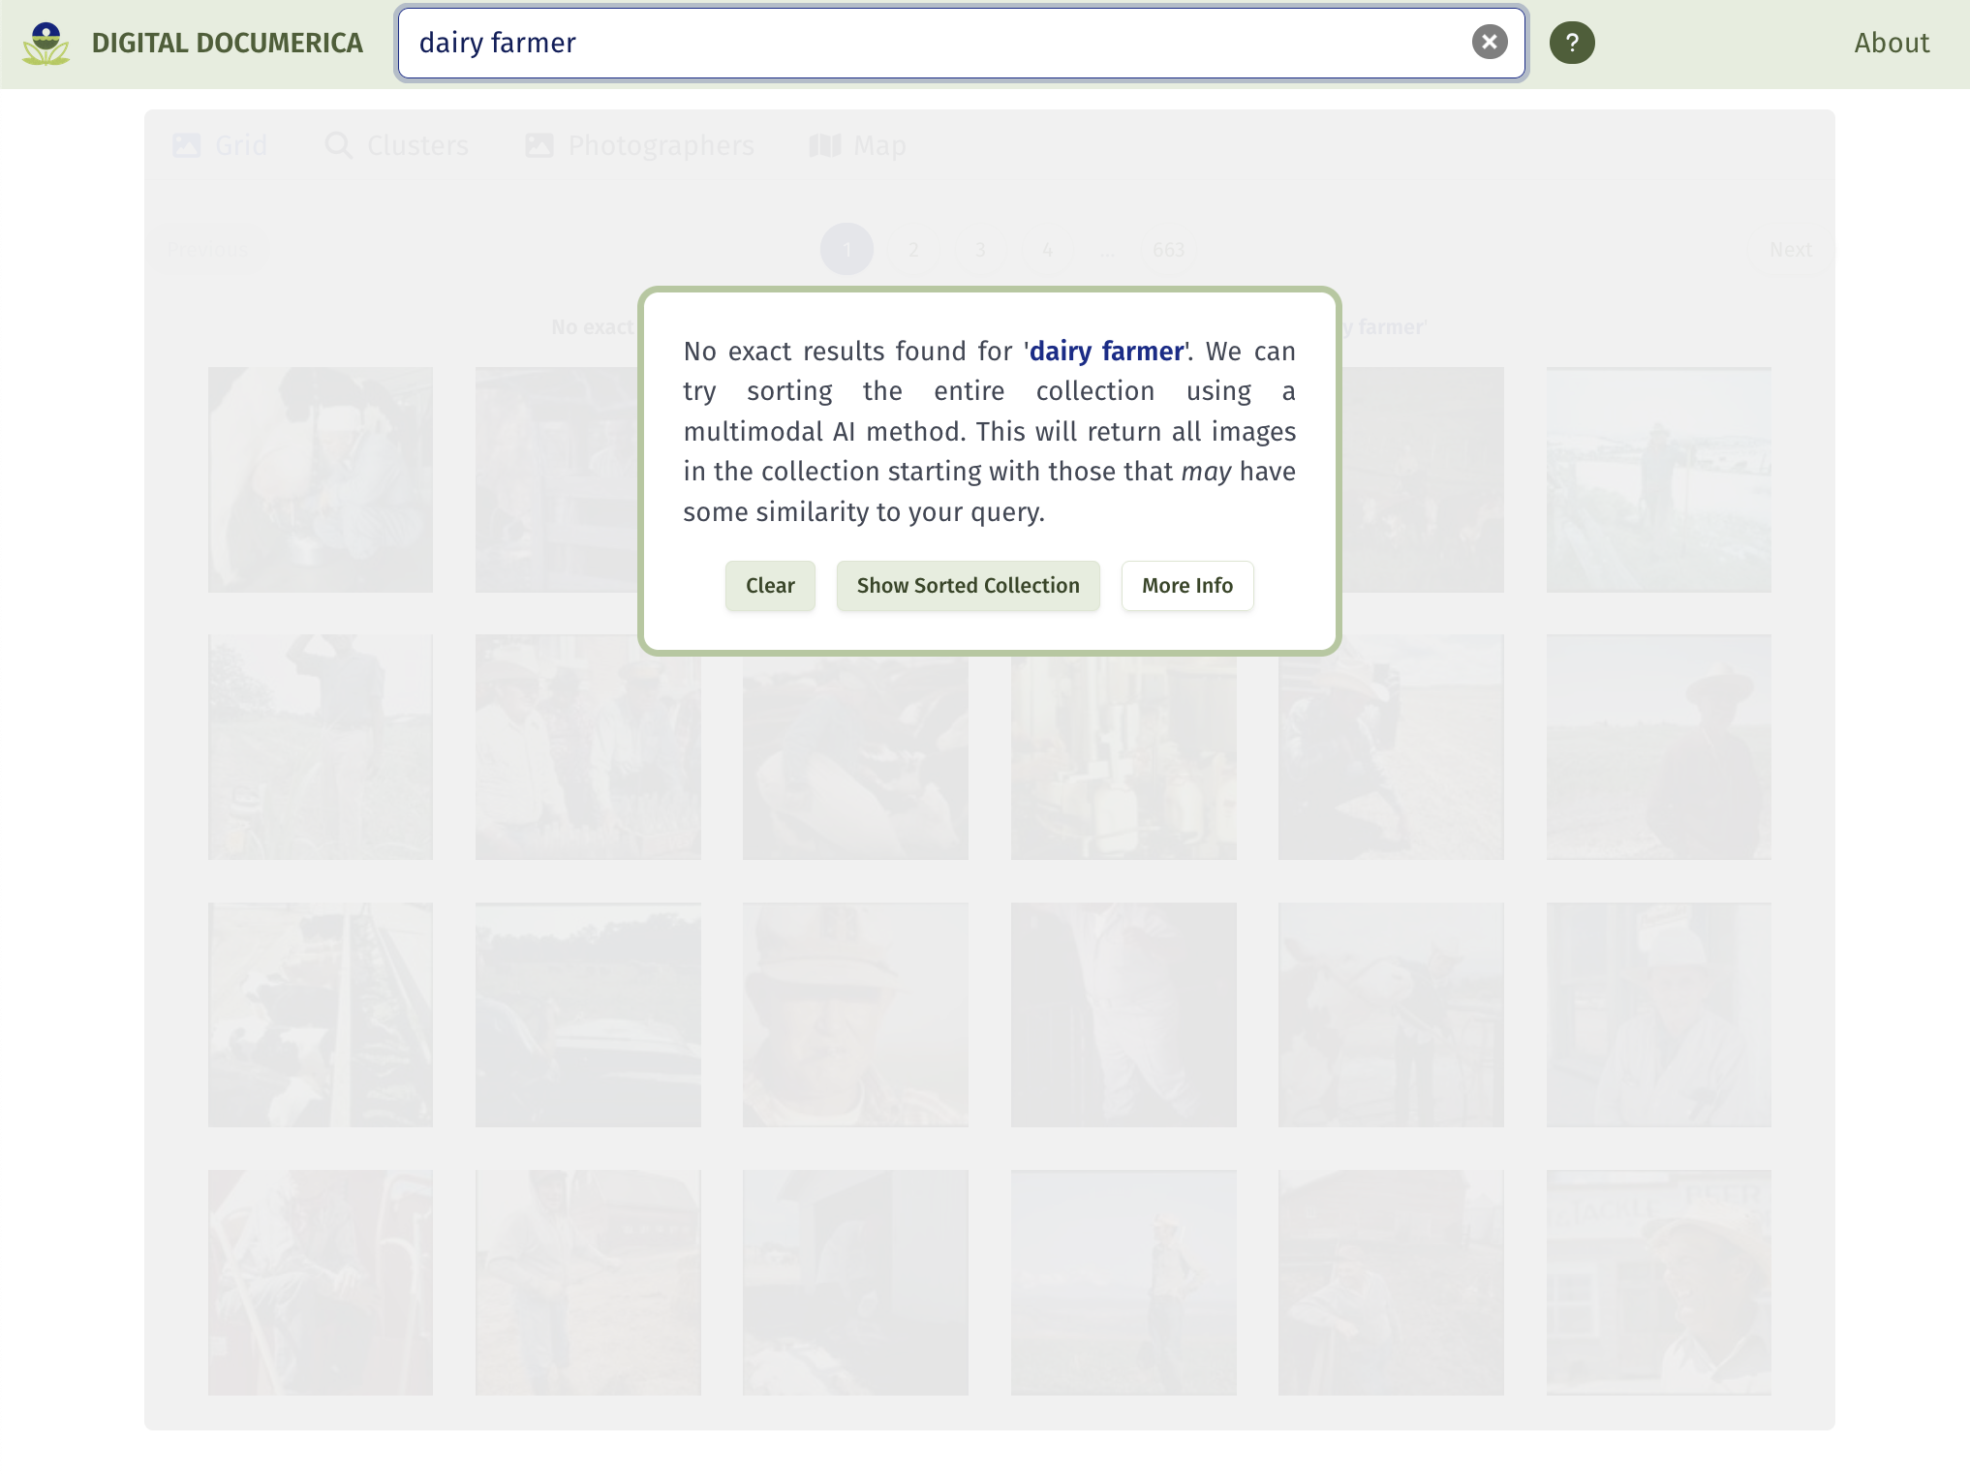
Digital Documerica
Consider now searching for something more specific, for example "dairy farmer". None of the captions contain this exact phrase, and the message warns the user about this.
However, we can still try to find images that are most similar to this phrase by using the SigLIP-base sort on the entire collection.
After user testing, we decided to make visitors to the site explicitly indicate that they are okay moving forward with this.
07 – Distant Viewing | Digital Documerica

Slide 51
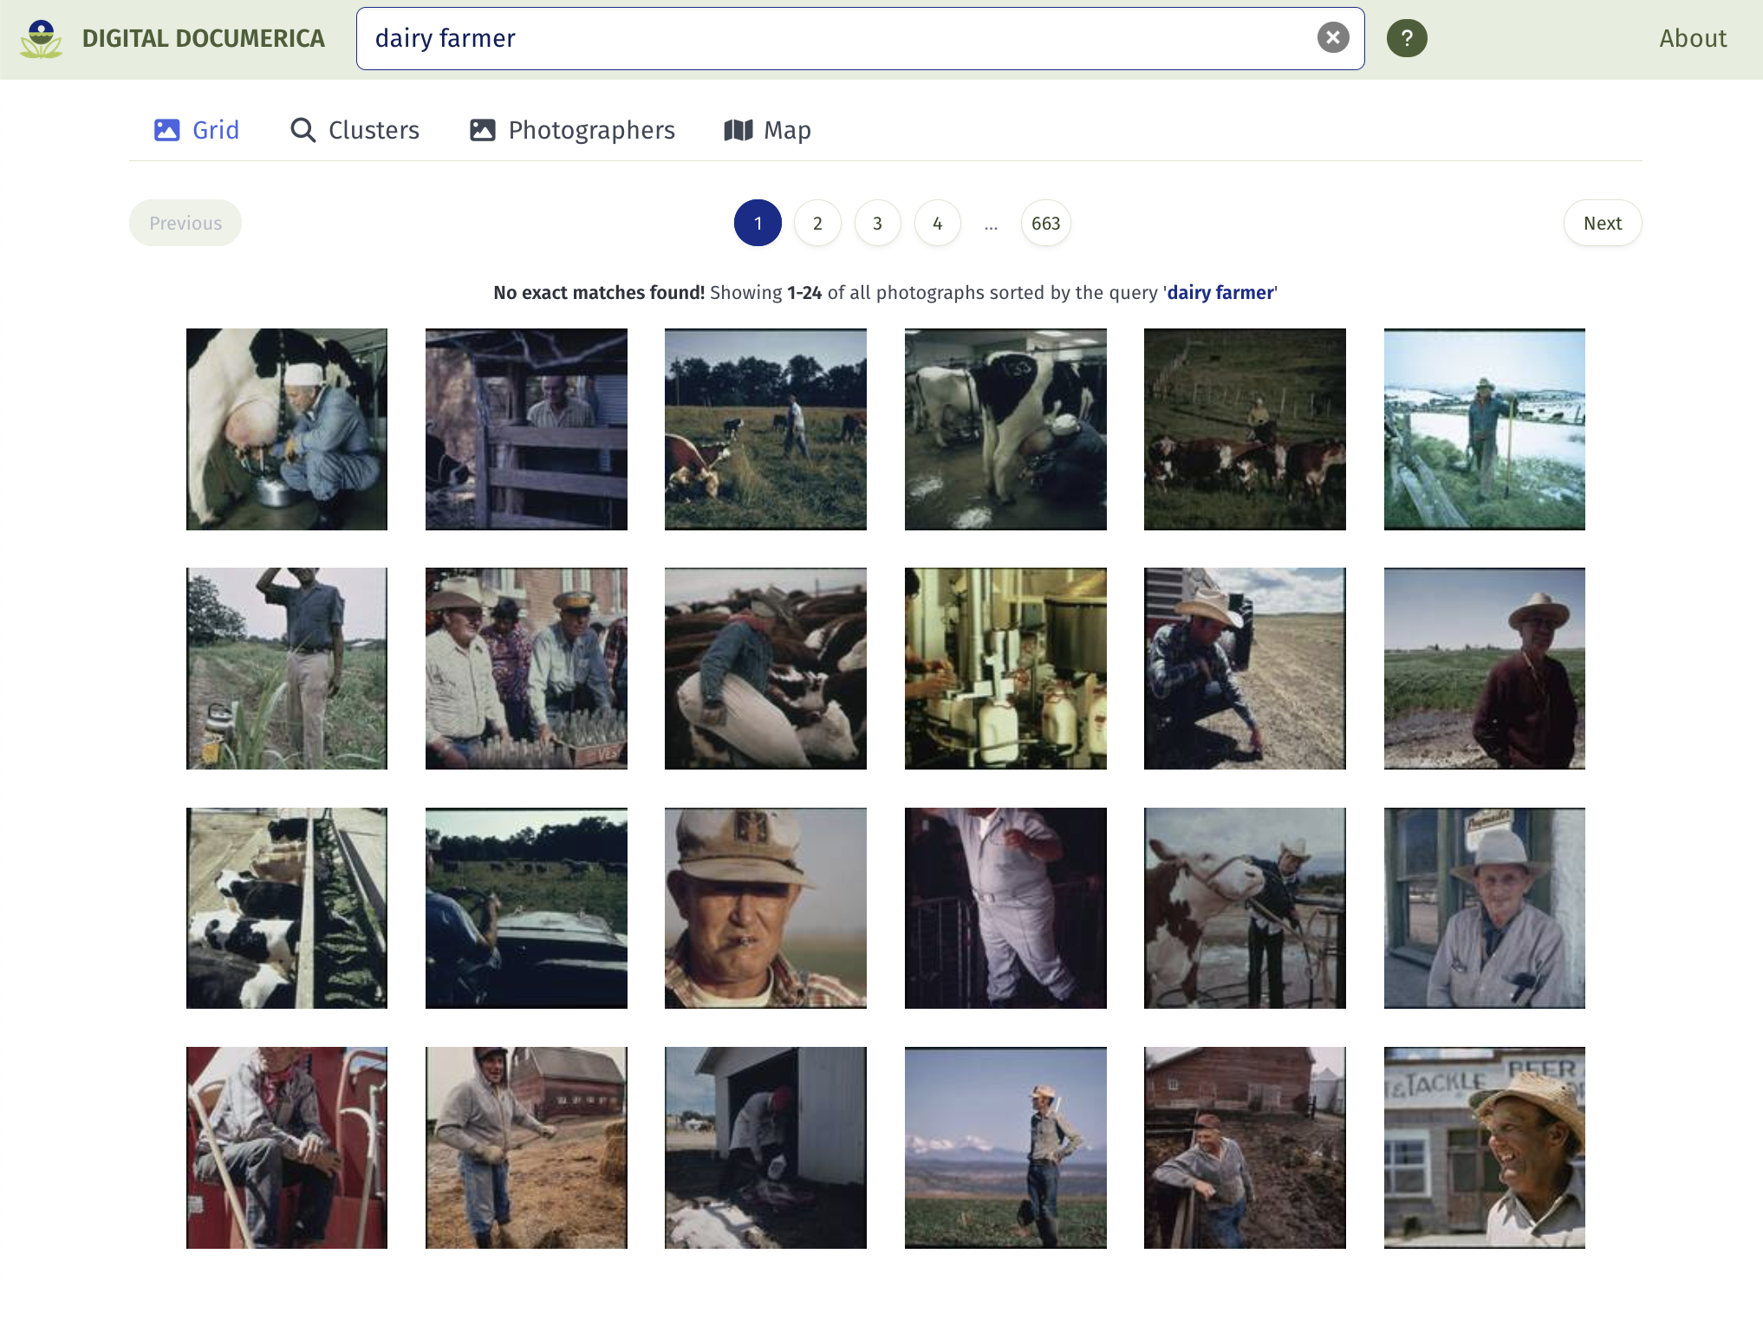
Digital Documerica
The output contains all the records sorted by the caption. In this case, we see that there are in fact many chairs with a green cushion.
This is great for finding very specific phrases in a corpus but does not work well for filtering. There is no good way to figure out how many of the top answers are in fact dairy farmers.
07 – Distant Viewing | Digital Documerica

Slide 52
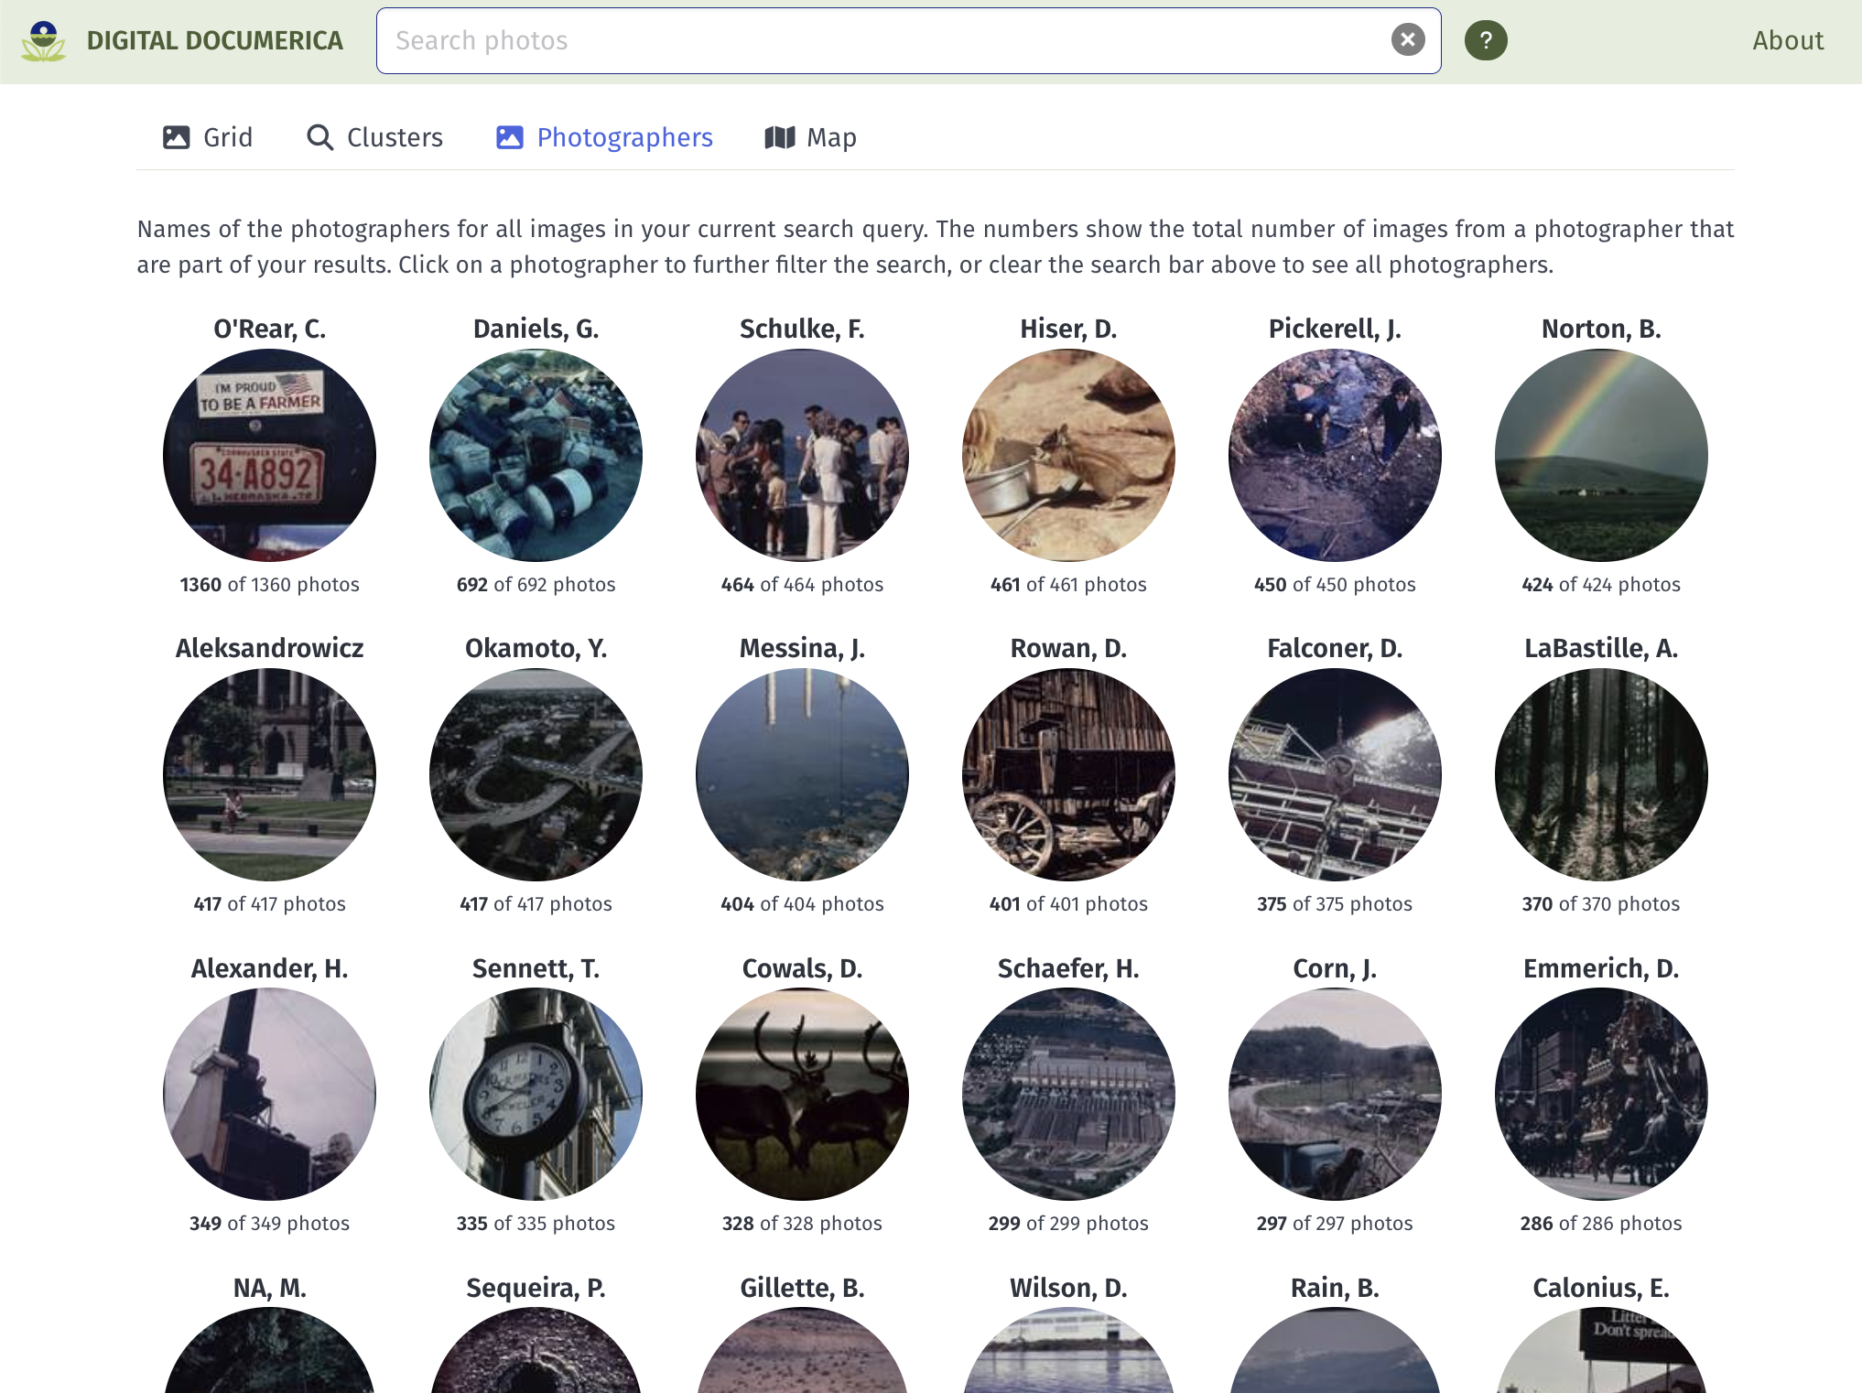
Metadata
While the multimodal techniques offer exciting new ways of exploring the collection, these should augment rather than replace the visualization of archival metadata. The Digital Documerica site allows, for example, to search by Photographer and Location.
07 – Distant Viewing | Digital Documerica

Slide 53

Metadata
While the multimodal techniques offer exciting new ways of exploring the collection, these should augment rather than replace the visualization of archival metadata. The Digital Documerica site allows, for example, to search by Photographer and Location.
07 – Distant Viewing | Digital Documerica

Slide 54

Display Techniques
Clicking on the image shows a specific page for each record. The archival data is shown at the top and the AI-generated data is shown at the bottom. These are clearly differentiated, and references provide more information.
The caption is likely not that useful for a production site (we can just view the image itself; very little is gained in most cases). But it is useful for understanding how the search functions work.
The keywords can be useful to suggest interesting search terms.
07 – Distant Viewing | Digital Documerica

Slide 55

Display Techniques
Here is an example of the about page describing the AI methods used in the site and explaining the specific methods used in the search algorithm.
07 – Distant Viewing | Digital Documerica

Slide 56
8. Materiality + Pre-processing
08 – Distant Viewing | Theory + MLLMs

Slide 57


Digital Documerica
The slides that were digitized by the National Archives were heavily damaged, causing a consistent red-shift to each of the images.
On the right are the images as provided on the NARA website. The have a heavy red shift that becomes even more noticeable when looking at multiple images.
However, there is another set of well-preserved prints that exist at NARA. Digitizing the entire collection would be costly, but can we do something computational in the meantime?
08 – Distant Viewing | Materiality

Slide 58


Digital Documerica
What if we consider the materiality of the slides themselves through the underlying chemistry of the Kodachrome and Ektachrome photographic slides?
08 – Distant Viewing | Materiality

Slide 59






Digital Documerica
We have been able to make, while not perfect reproductions, much more aesthetically pleasing and natural looking images by color correcting the damaged digitized slides.
ORIGINAL
CORRECTED
08 – Distant Viewing | Materiality

Slide 60
8. Distant Viewing: Theory + MLLMs
08 – Distant Viewing | Theory + MLLMs

Slide 61

Distant Viewing: Theory + MLLMs
Flip Schulke, Employee of the Donald Dannheim Family who operate a dairy and ice cream store (July 1974).
The core ideas from the theory of distant viewing is that we need to create annotations to do computational analysis of digital images, that the creation of these annotations can be thought of as a digitally-mediated form of viewing at a distance, and that these forms of viewing at a distance are both subject and destructive.
MLLM model + prompt
This photograph captures a scene inside an industrial or agricultural processing facility, possibly a dairy. The image focuses on a female worker engaged in operating machinery used for filling milk bottles….
08 – Distant Viewing | Theory + MLLMs

Slide 62
Distant Viewing: Theory + MLLMs
Flip Schulke, Employee of the Donald Dannheim Family who operate a dairy and ice cream store (July 1974).
The core ideas from the theory of distant viewing is that we need to create annotations to do computational analysis of digital images, that the creation of these annotations can be thought of as a digitally-mediated form of viewing at a distance, and that these forms of viewing at a distance are both subject and destructive.
The potential power of MLLMs for working with collections of digital images further highlights each of these points. Turning images into textual descriptions is arguable closer to the way that we interpret images than previous types of computer vision annotations. Also, these new algorithms have a wide-open set of configurations and options through the choice of prompts and text filtering that accentuate how our decision making that influences the resulting output.
MLLM model + prompt
This photograph captures a scene inside an industrial or agricultural processing facility, possibly a dairy. The image focuses on a female worker engaged in operating machinery used for filling milk bottles….
08 – Distant Viewing | Theory + MLLMs

Slide 63
Distant Viewing: Theory + MLLMs
Flip Schulke, Employee of the Donald Dannheim Family who operate a dairy and ice cream store (July 1974).
The core ideas from the theory of distant viewing is that we need to create annotations to do computational analysis of digital images, that the creation of these annotations can be thought of as a digitally-mediated form of viewing at a distance, and that these forms of viewing at a distance are both subject and destructive.
The potential power of MLLMs for working with collections of digital images further highlights each of these points. Turning images into textual descriptions is arguable closer to the way that we interpret images than previous types of computer vision annotations. Also, these new algorithms have a wide-open set of configurations and options through the choice of prompts and text filtering that accentuate how our decision making that influences the resulting output.
In the era of large language models, understanding the implications of the theory of distant viewing is more important than ever.
MLLM model + prompt
This photograph captures a scene inside an industrial or agricultural processing facility, possibly a dairy. The image focuses on a female worker engaged in operating machinery used for filling milk bottles….
08 – Distant Viewing | Theory + MLLMs

Slide 64

THANK YOU!
Please get in touch!
distantviewing.org
tarnold2@richmond.edu
digitaldocumerica.org

